Slide 1
Communicating with Data – Intro to Tableau
Dr. Ab Mosca (they/them)
Slides based off slides courtesy of Jordan Crouser (https://jcrouser.github.io/)

Slide 2
Plan for Today
Introduction to Tableau
Lab pt. 1 - Getting started:
Connecting to a data file
Creating views
Using “Show Me”: a recommender system for views
Lab pt. 2 - Exploring other datasets
Discussion (time permitting)
Lab pt. 1 modeled on “Getting Started with Tableau Desktop” Version 8.2
Last Updated June 11, 2014 3:09 PM Copyright © 2014 Tableau Software

Slide 3
Reminder
hw01 is released today! (https://amosca01.github.io/SDS-CS109/ > Homework > hw01)
Due next Thursday (09/19) at midnight
You have extensions if you need them, but you MUST tell me if you’re taking one
Revise and resubmit also exists!
Work alone or with a partner (you choose!)
**I won’t always remind you there is a homework released/due, make sure you stay up to date with the course schedule! **

Slide 4

A drag-and-drop tool for mapping data dimensions onto visual dimensions
Today we will learn:
How to load data into Tableau
A little bit about how Tableau organizes data
How to tell Tableau which facets of the data to display, and how
Introduction to Tableau

Slide 5

Visualization and business analytics software with a strong focus on relational data
Idea originally developed at Stanford University
Now owned by Salesforce
What is
?

Slide 6
Visualization and business analytics software with a strong focus on relational data
Idea originally developed at Stanford University
Now owned by Salesforce
What is
?
What’s relational data?

Slide 7
airlines
#> # A tibble: 16 × 2
#> carrier name
#> <chr> <chr>
#> 1 9E Endeavor Air Inc.
#> 2 AA American Airlines Inc.
#> 3 AS Alaska Airlines Inc.
#> 4 B6 JetBlue Airways
#> 5 DL Delta Air Lines Inc.
#> 6 EV ExpressJet Airlines Inc.
#> # i 10 more rows
Relational Data
airports
#> # A tibble: 1,458 × 8
#> faa name lat lon alt tz dst tzone
#> <chr> <chr> <dbl> <dbl> <dbl> <dbl> <chr> <chr>
#> 1 04G Lansdowne Airport 41.1 -80.6 1044 -5 A America/Ne…
#> 2 06A Moton Field Municipal Airport 32.5 -85.7 264 -6 A America/Ch…
#> 3 06C Schaumburg Regional 42.0 -88.1 801 -6 A America/Ch…
#> 4 06N Randall Airport 41.4 -74.4 523 -5 A America/Ne…
#> 5 09J Jekyll Island Airport 31.1 -81.4 11 -5 A America/Ne…
#> 6 0A9 Elizabethton Municipal Airport 36.4 -82.2 1593 -5 A America/Ne…
#> # i 1,452 more rows
planes
#> # A tibble: 3,322 × 9
#> tailnum year type manufacturer model engines seats speed engine
#> <chr> <int> <chr> <chr> <chr> <int> <int> <int> <chr>
#> 1 N10156 2004 Fixed wing multi … EMBRAER EMB-… 2 55 NA Turbo…
#> 2 N102UW 1998 Fixed wing multi … AIRBUS INDU… A320… 2 182 NA Turbo…
#> 3 N103US 1999 Fixed wing multi … AIRBUS INDU… A320… 2 182 NA Turbo…
#> 4 N104UW 1999 Fixed wing multi … AIRBUS INDU… A320… 2 182 NA Turbo…
#> 5 N10575 2002 Fixed wing multi … EMBRAER EMB-… 2 55 NA Turbo…
#> 6 N105UW 1999 Fixed wing multi … AIRBUS INDU… A320… 2 182 NA Turbo…
#> # i 3,316 more rows
weather
#> # A tibble: 26,115 × 15
#> origin year month day hour temp dewp humid wind_dir wind_speed wind_gust
#> <chr> <int> <int> <int> <int> <dbl> <dbl> <dbl> <dbl> <dbl> <dbl>
#> 1 EWR 2013 1 1 1 39.0 26.1 59.4 270 10.4 NA
#> 2 EWR 2013 1 1 2 39.0 27.0 61.6 250 8.06 NA
#> 3 EWR 2013 1 1 3 39.0 28.0 64.4 240 11.5 NA
#> 4 EWR 2013 1 1 4 39.9 28.0 62.2 250 12.7 NA
#> 5 EWR 2013 1 1 5 39.0 28.0 64.4 260 12.7 NA
#> 6 EWR 2013 1 1 6 37.9 28.0 67.2 240 11.5 NA
#> # i 26,109 more rows
#> # i 4 more variables: precip <dbl>, pressure <dbl>, visib <dbl>,
#> # time_hour <dttm>
https://r4ds.had.co.nz/relational-data.html

Slide 8
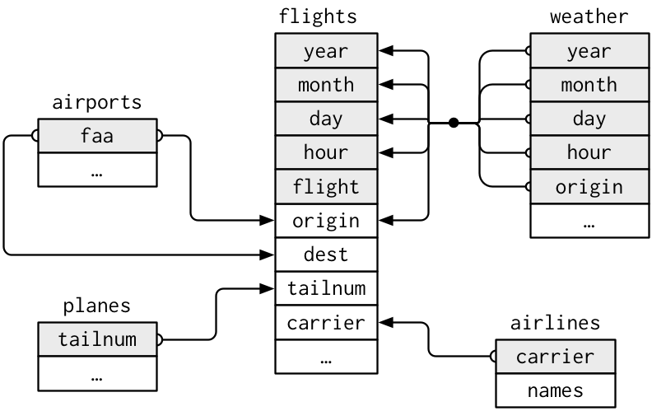
Relational Data
https://r4ds.had.co.nz/relational-data.html

Slide 9
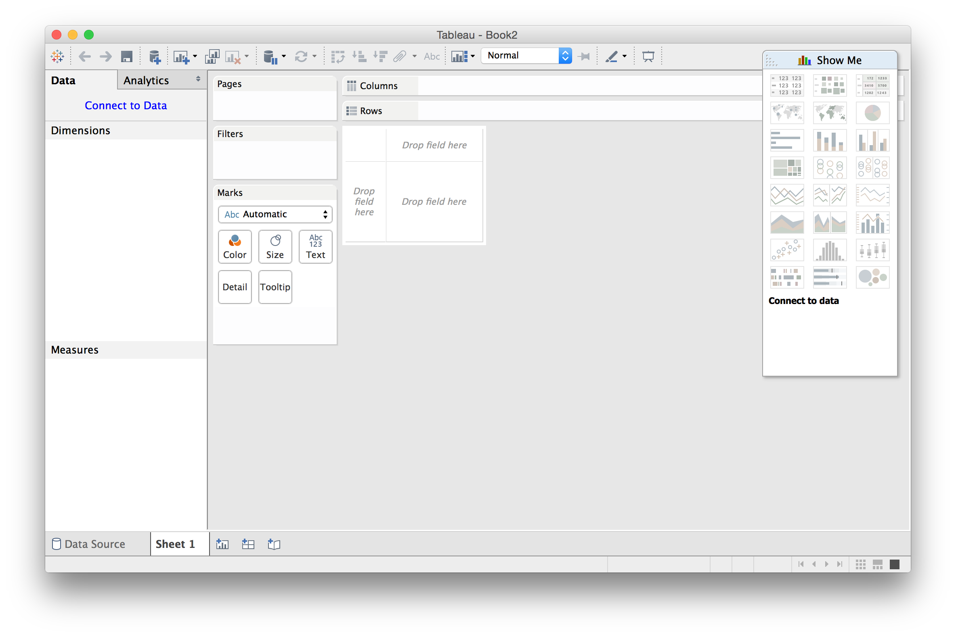
Main Window: New Workbook
Tableau basics

Slide 10
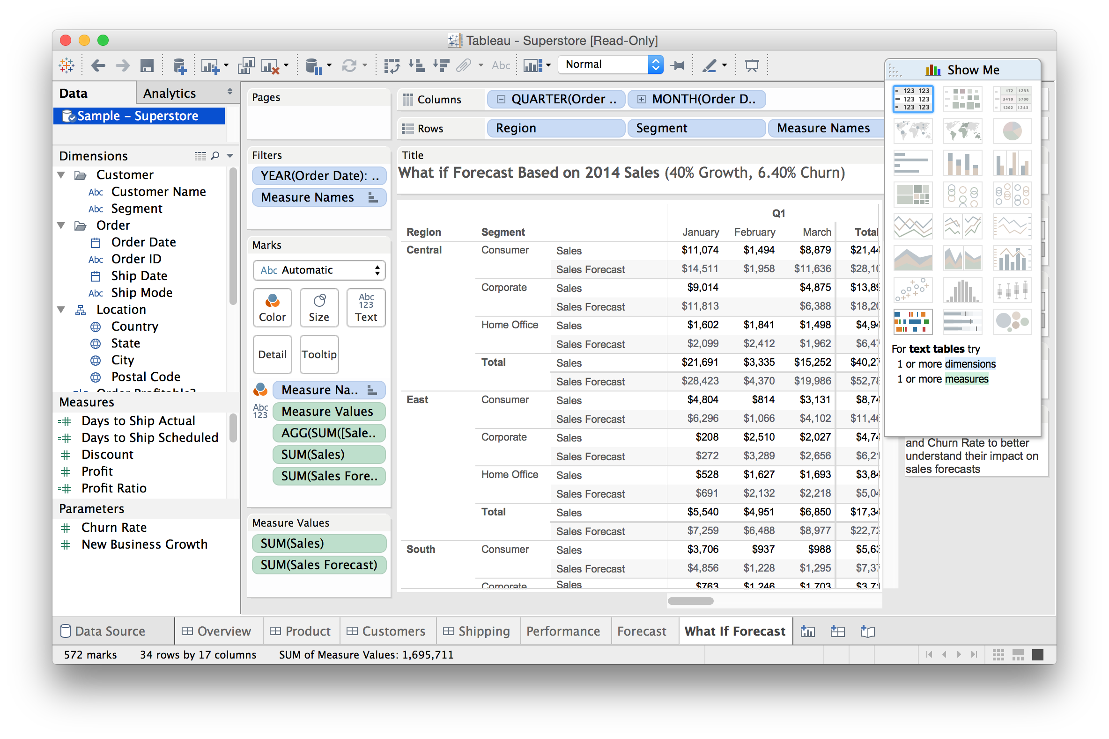
Main Window: with Data and Views
Tableau basics

Slide 11
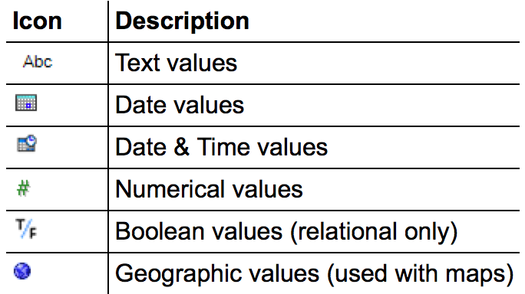
Data Types
Tableau basics
All data fields are assigned one of the following types:
Occasionally the auto-detected type is wrong; this can be manually overridden using the menu

Slide 12
Main Window: with Data and Views
Tableau basics

Slide 13
Data Roles: Dimensions
Tableau basics
In general, any field containing qualitative or categorical information is treated as a dimension (e.g. text, dates)
In relational data, dimensions are the independent variables
Data can be aggregated using the values of a dimension
When added as rows/columns, dimensions produce headers

Slide 14
Data Roles: Measures
Tableau basics
In general, any field containing quantitative information is treated as a measure (e.g. numerical data, etc.)
In relational data, measures are the dependent variables
The values of a measure are a function of one or more dimensions
When added as rows/columns, measures produce axes

Slide 15

Data Roles: Dimensions vs. Measures
Tableau basics
measure
dimension
Which is which?
total number of students in each house
Which is which?
total number of students in each house
Which is which?
total number of students in each house

Slide 16
Main Window: with Data and Views
Tableau basics

Slide 17
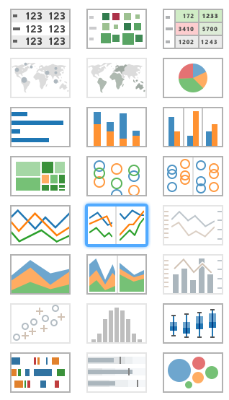
21 Available Views
Tableau basics
Tables
Maps
Pie charts
Bar charts
Treemaps
Circle views
Line charts
Area charts
Combination charts
Scatterplots
Histograms
Box-and-whisker plots
Gantt
Bullet plots
Packed circles
Tables
Maps
Pie charts
Bar charts
Treemaps
Circle views
Line charts
Area charts
Combination charts
Scatterplots
Histograms
Box-and-whisker plots
Gantt
Bullet plots
Packed circles

Slide 18
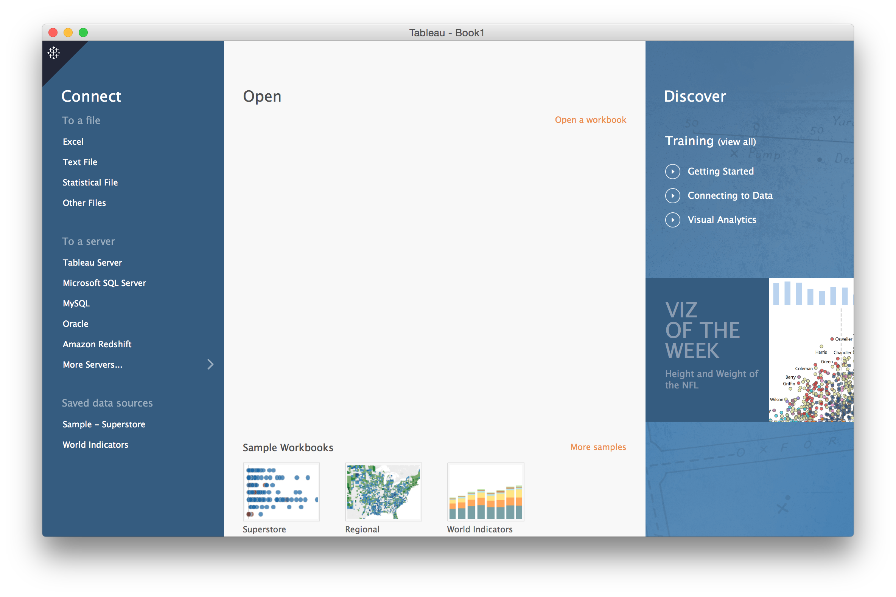
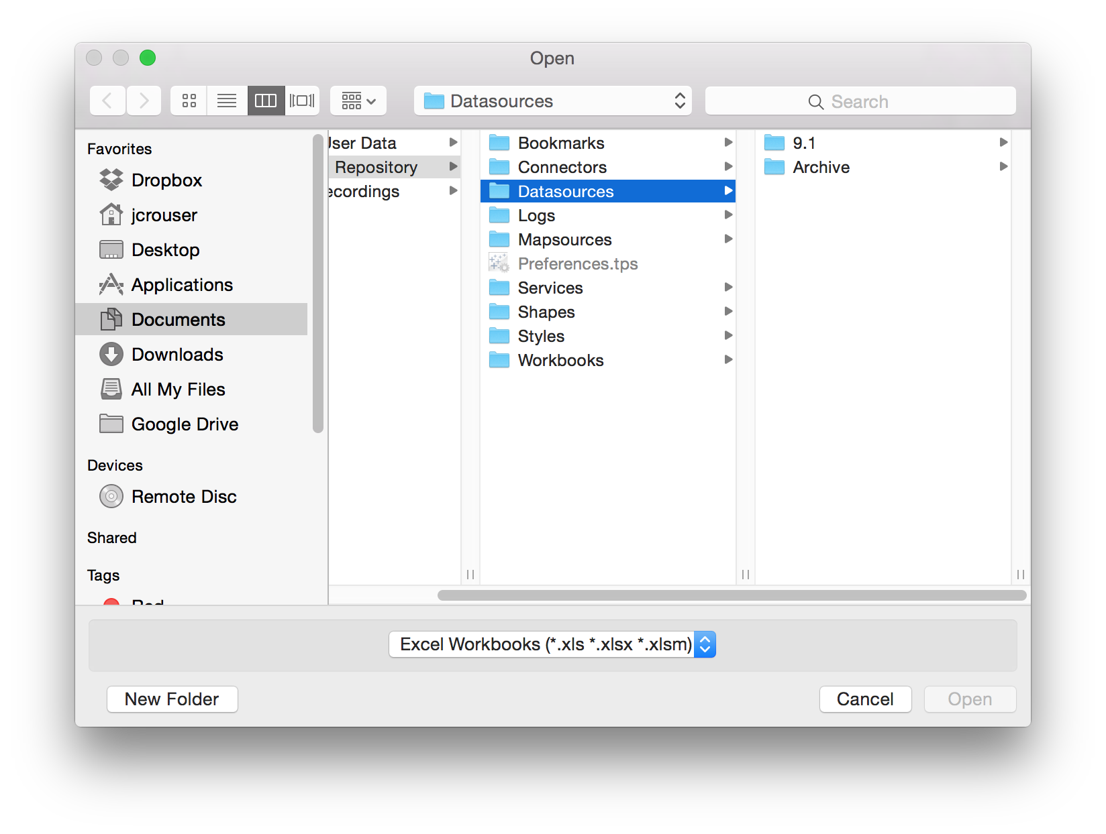
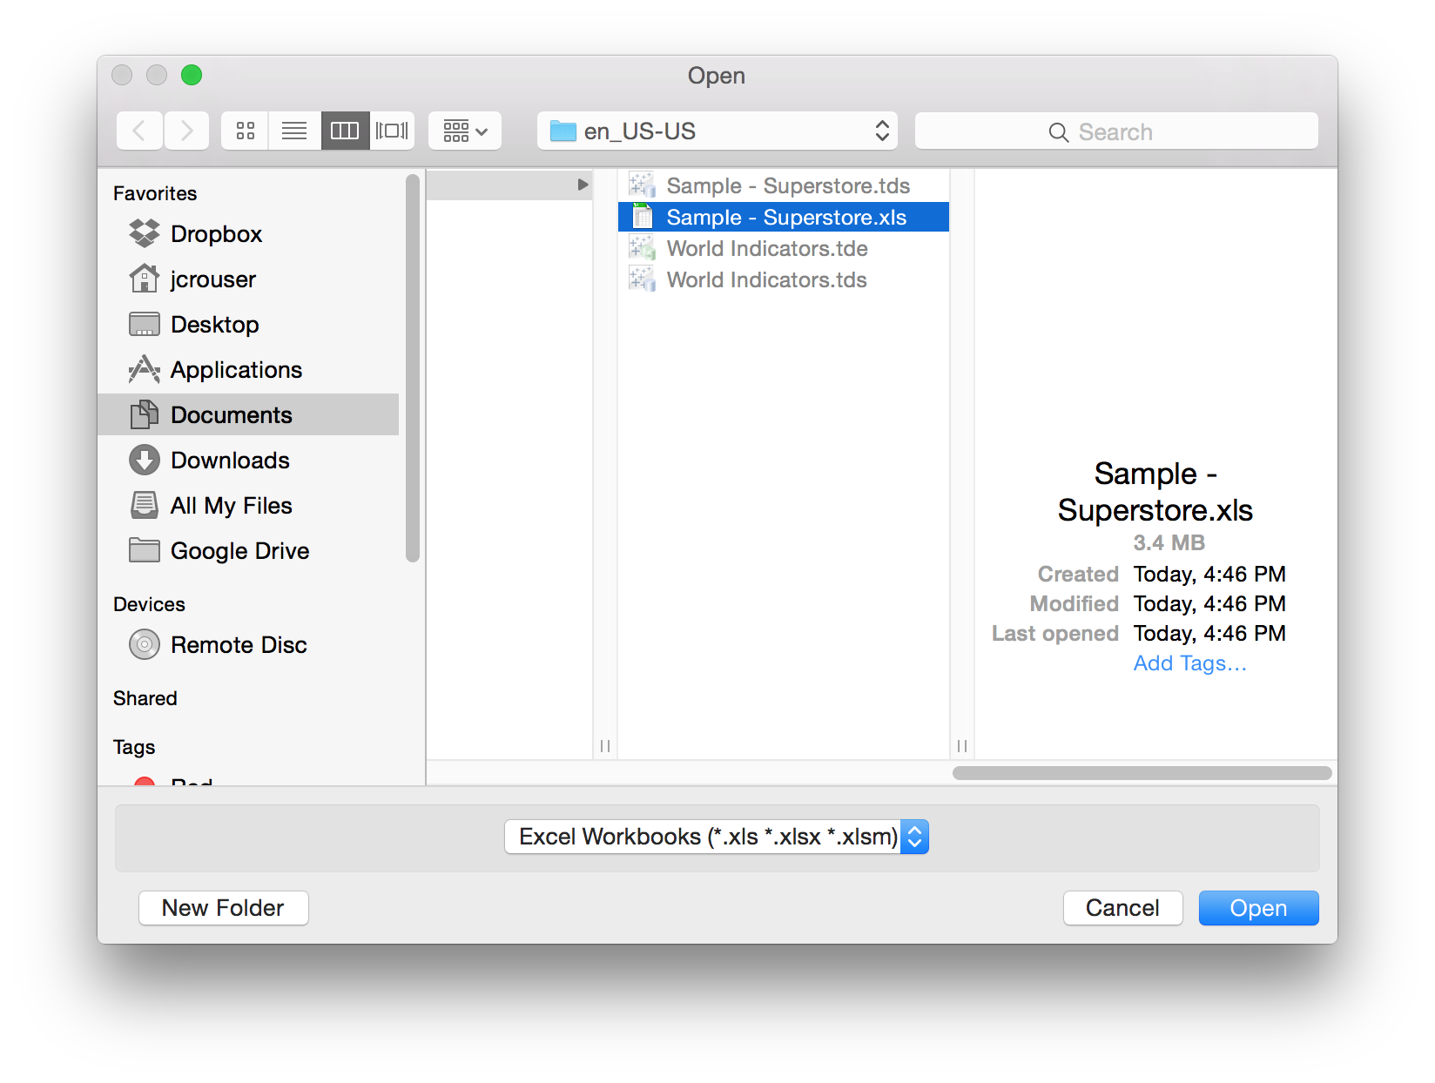
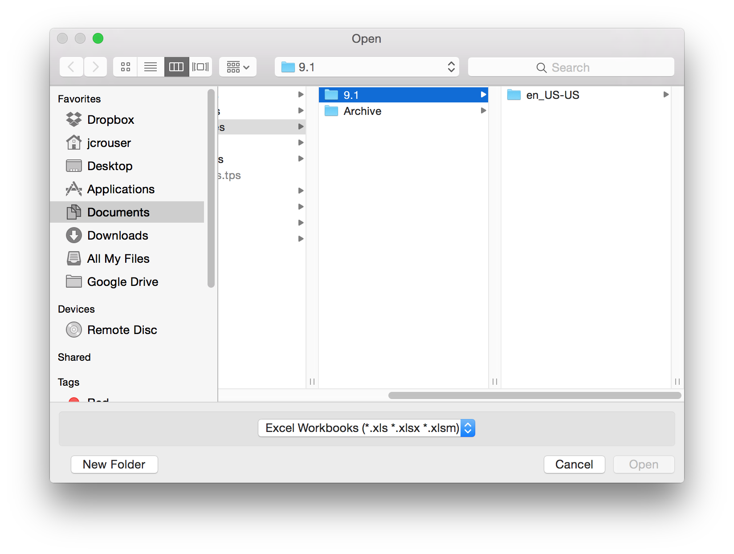
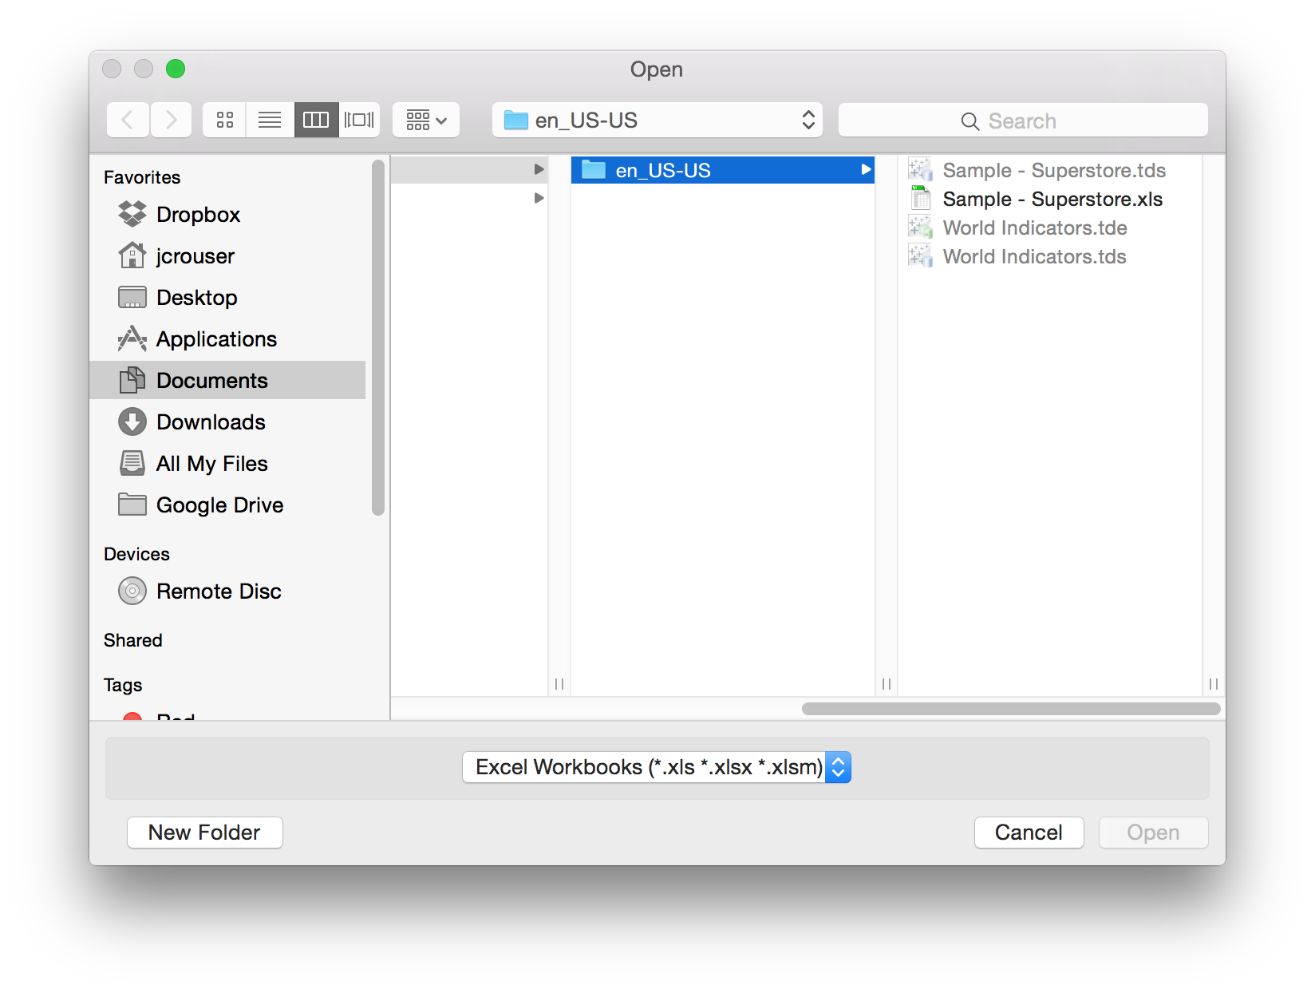
Lab pt. 1: Getting Started
Tableau basics

Slide 19
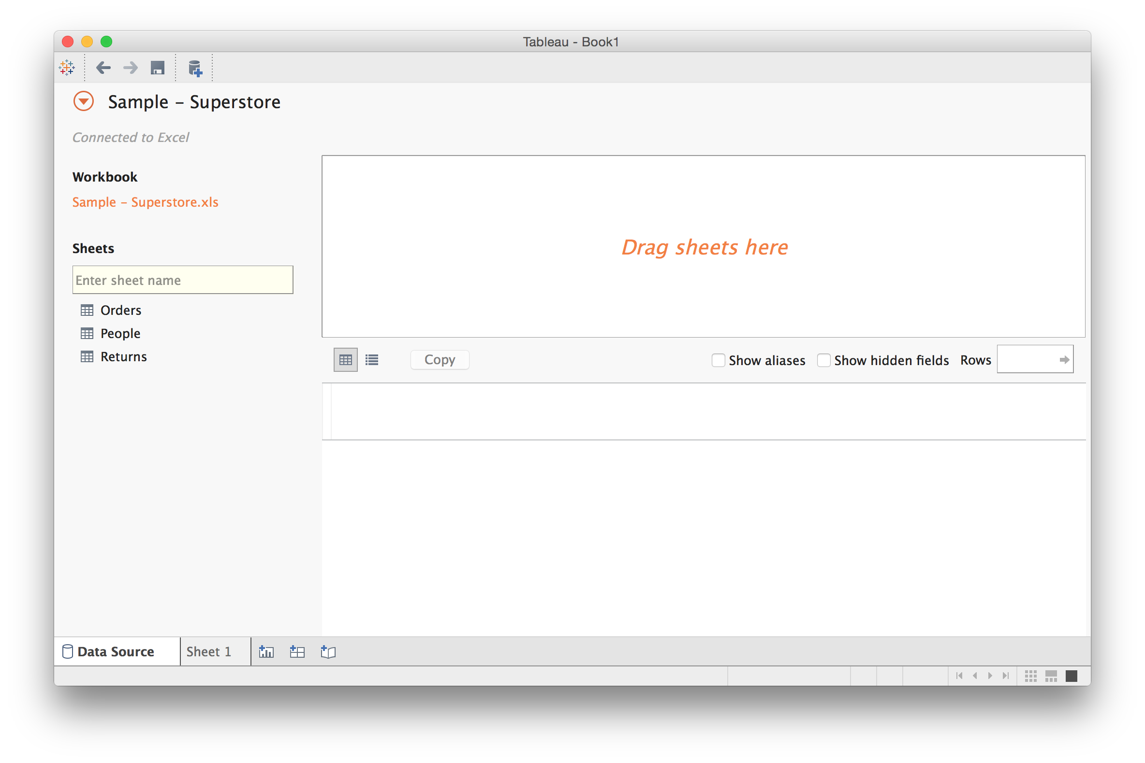
Connecting to a Data File
Tableau basics

Slide 20
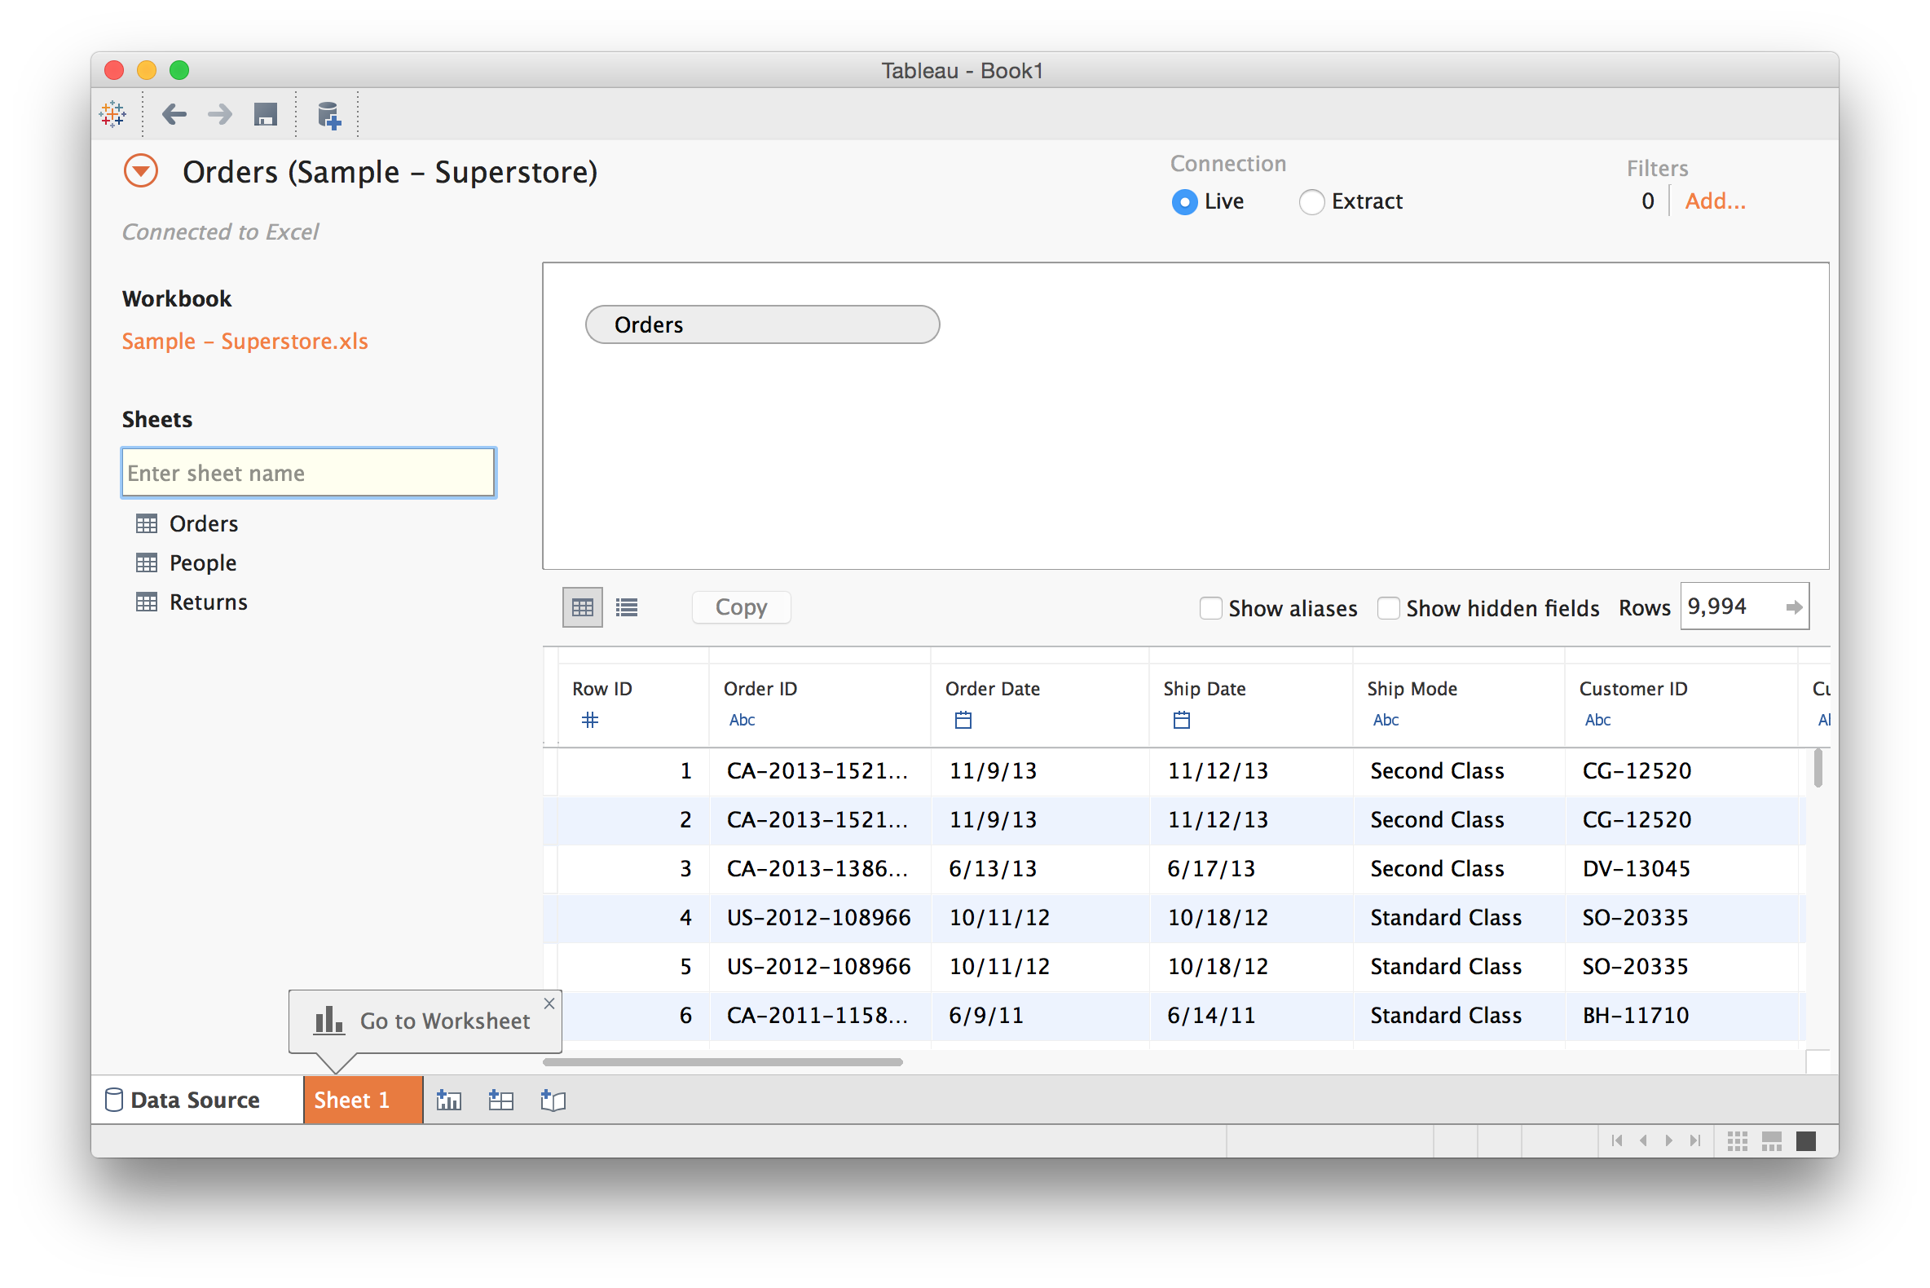
Connecting to a Data File
Tableau basics

Slide 21
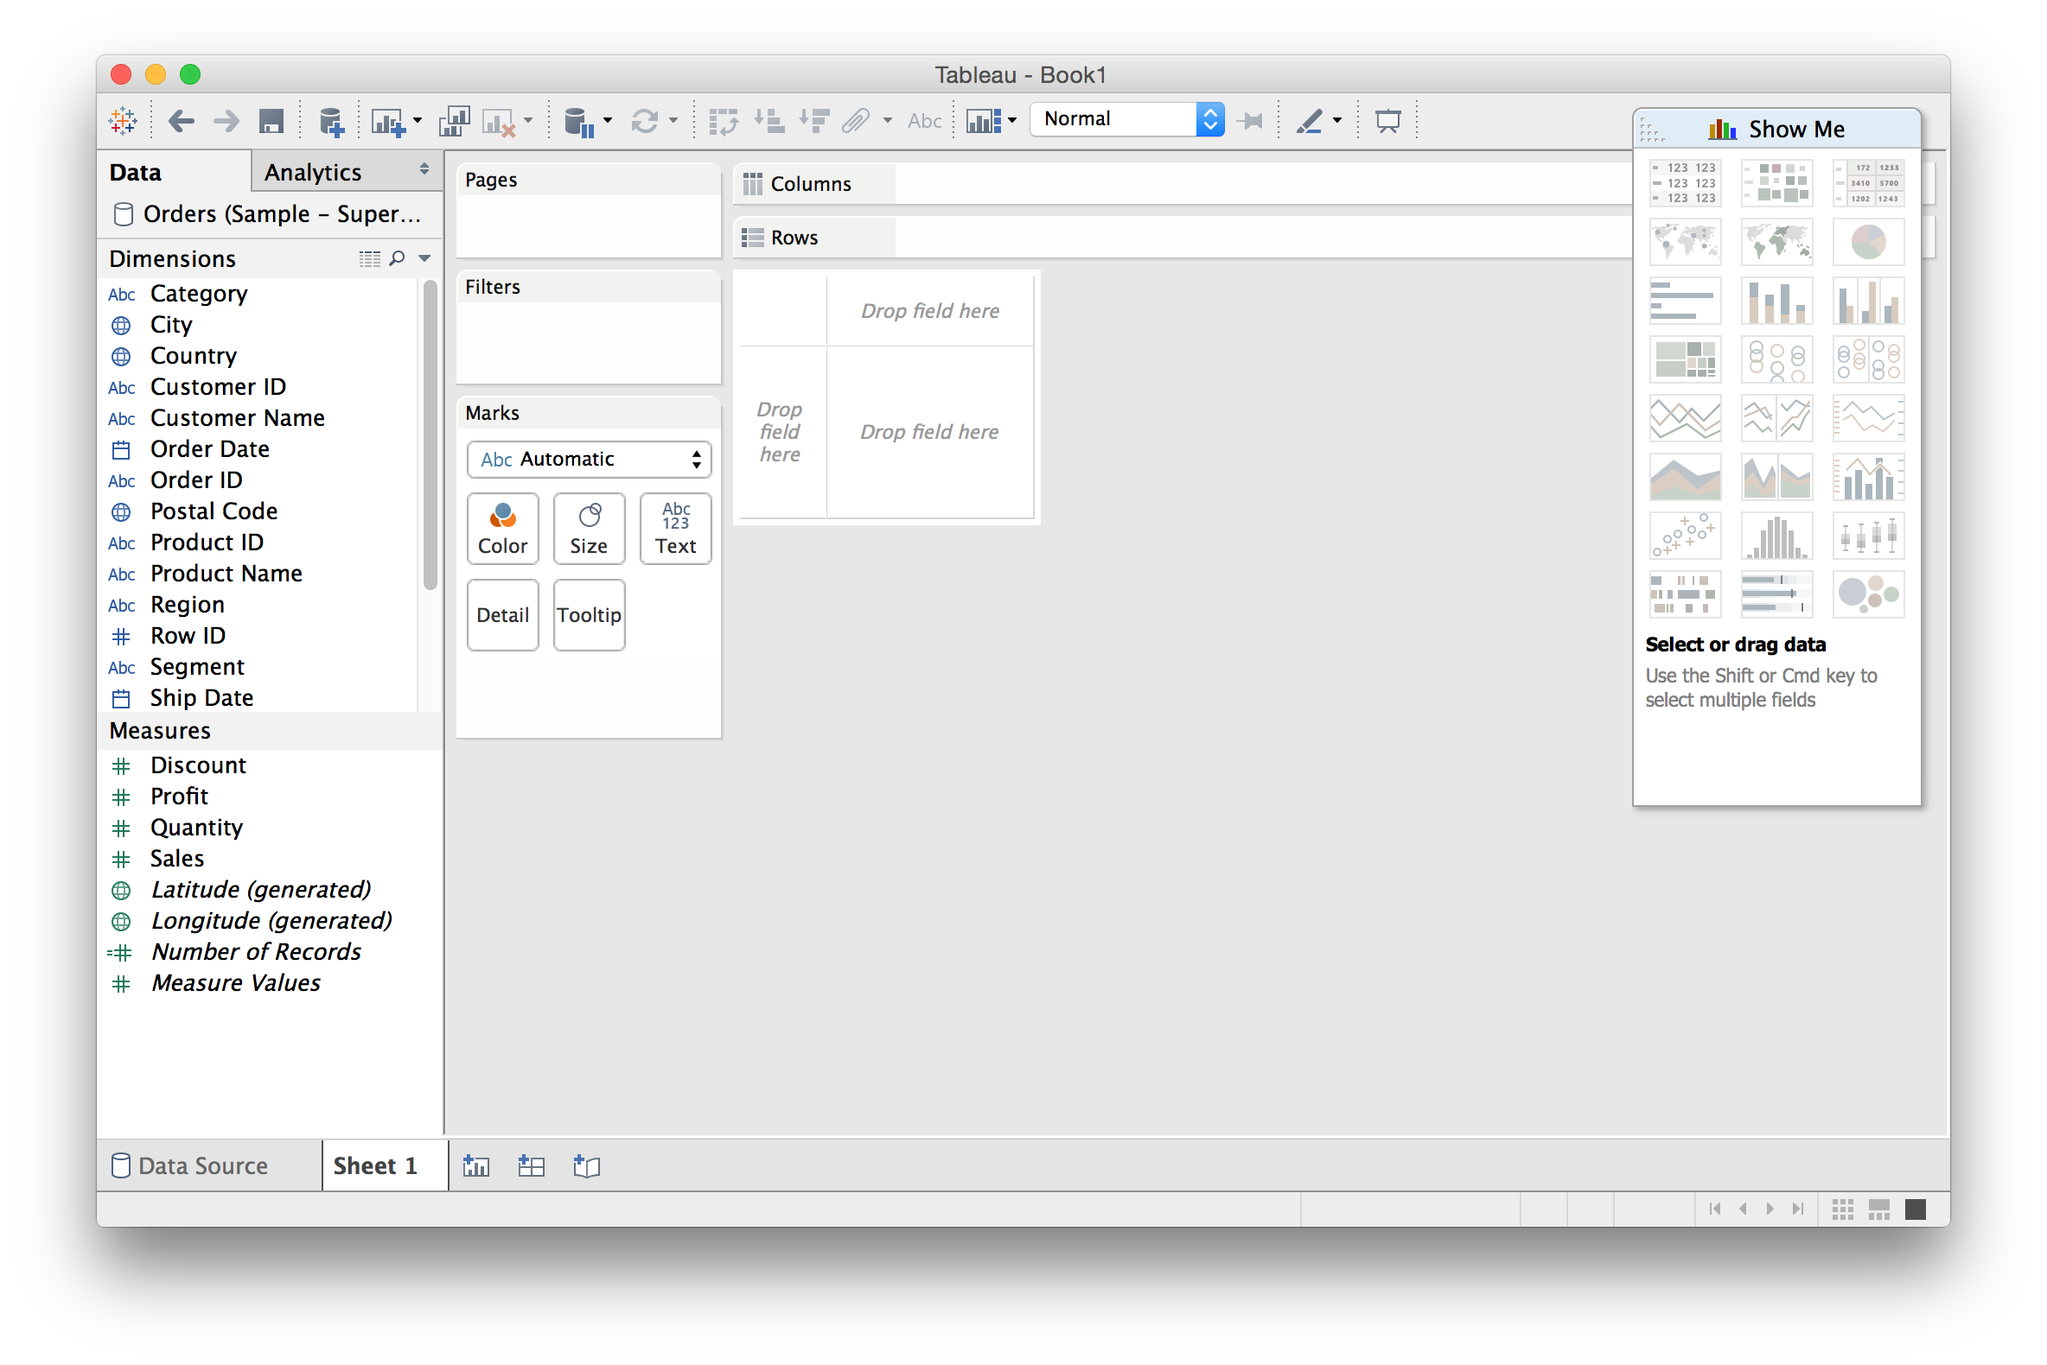
Creating Views
Tableau basics

Slide 22
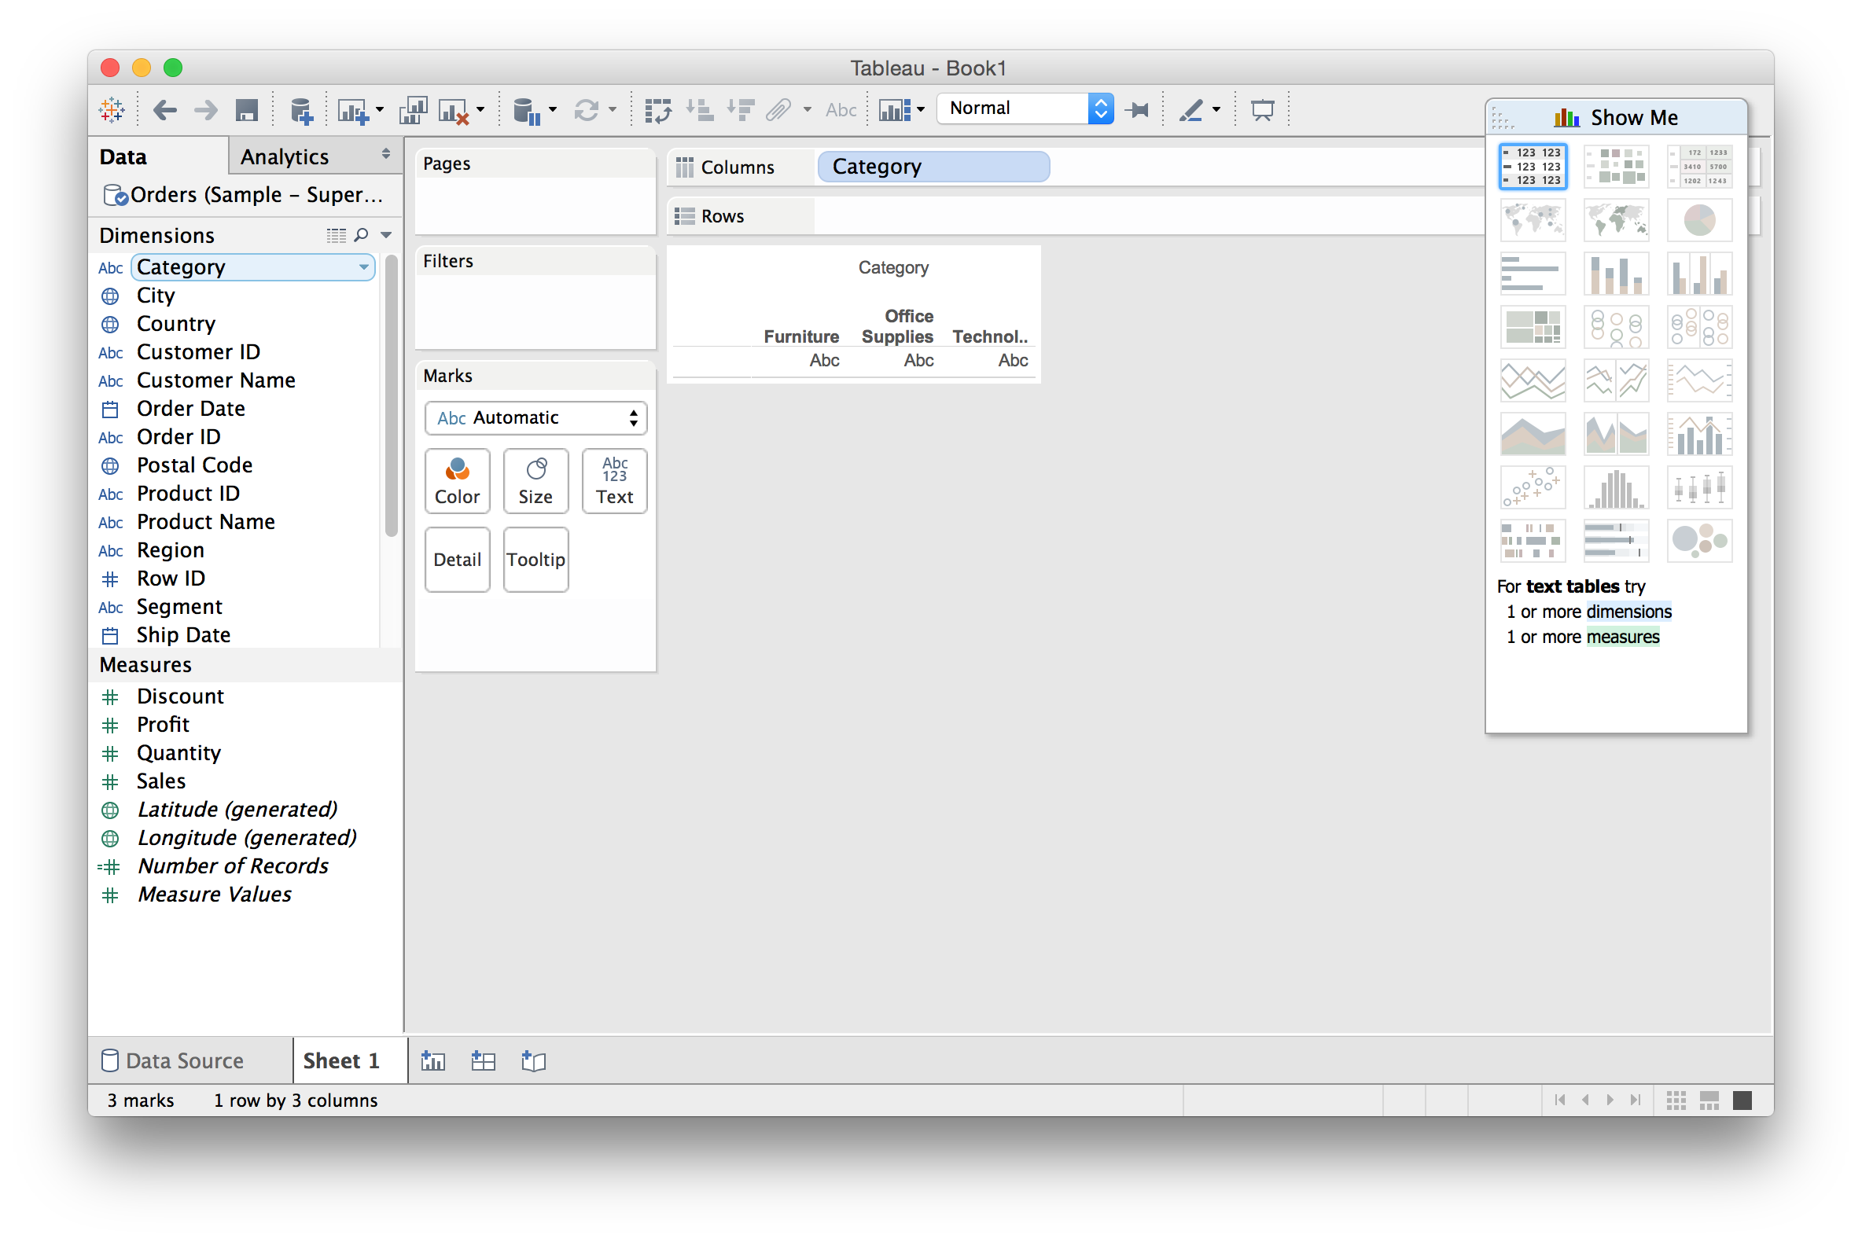
Drag a dimension to “Columns”
Tableau basics

Slide 23
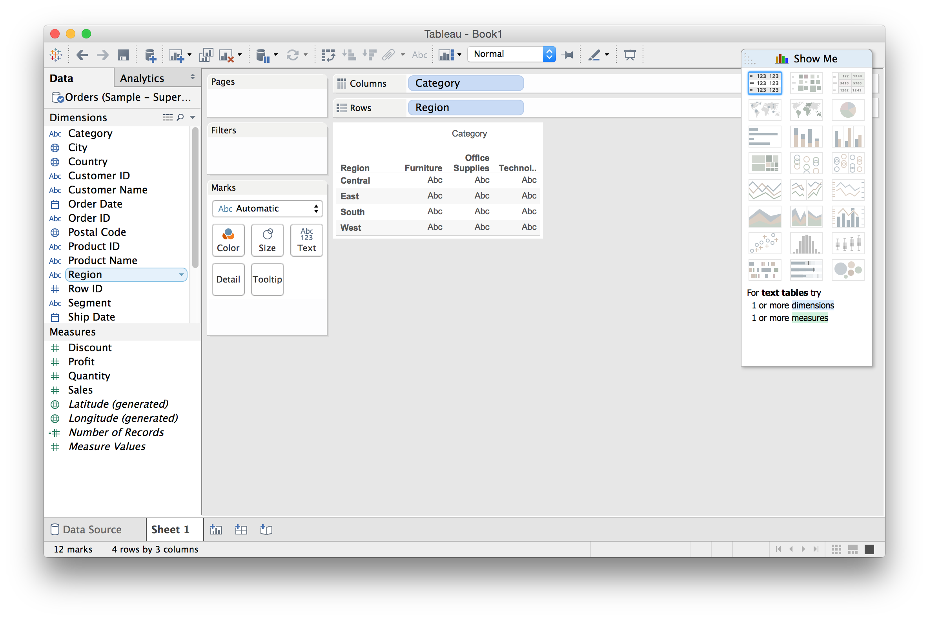
Drag a dimension to “Rows”
Tableau basics

Slide 24
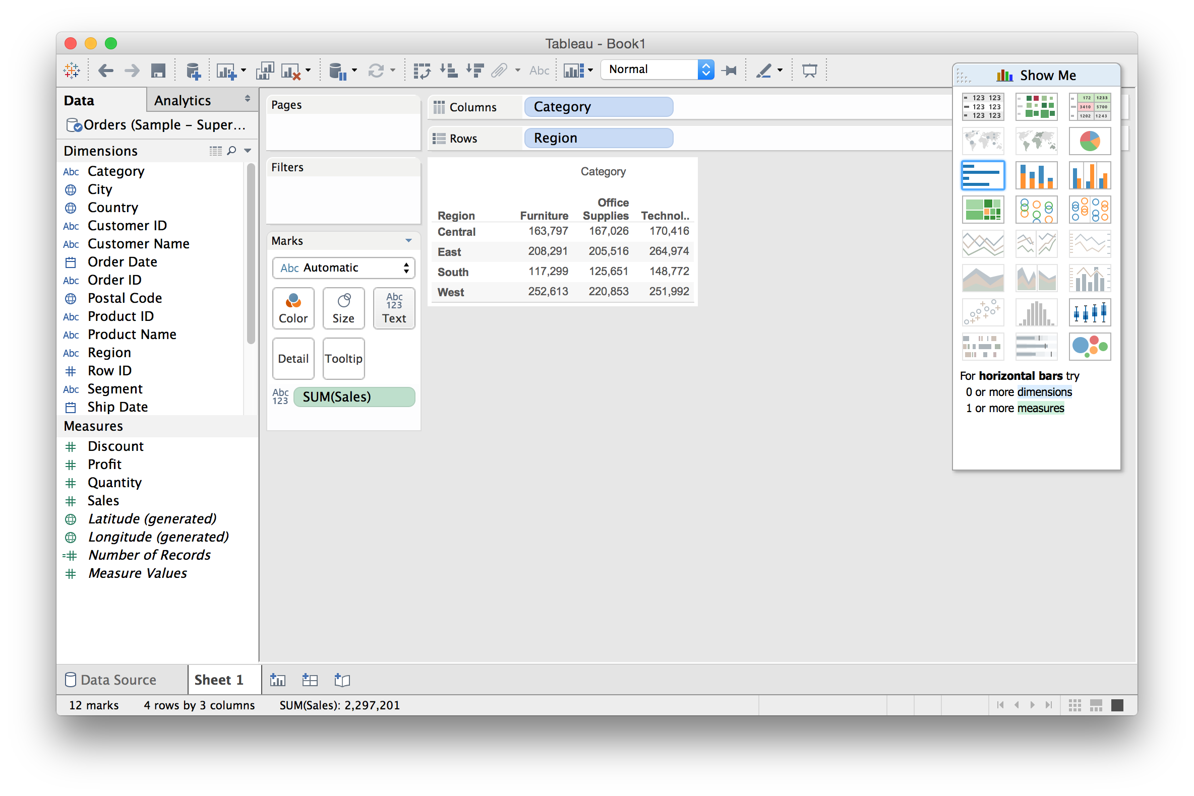
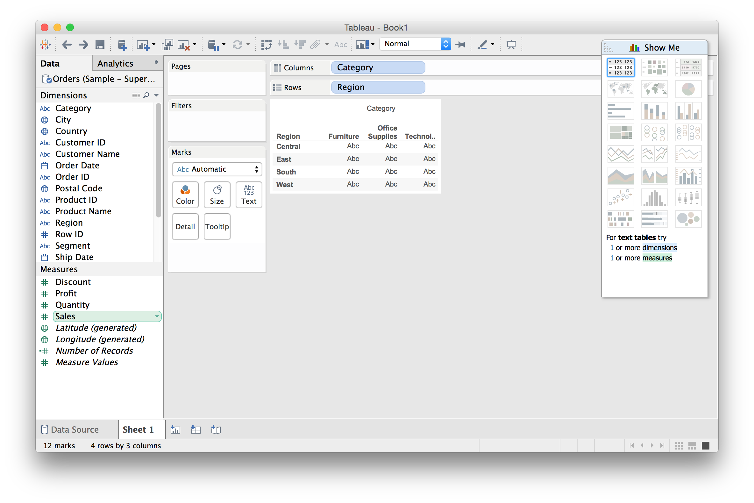
Drag a measure onto “Text”
Tableau basics

Slide 25
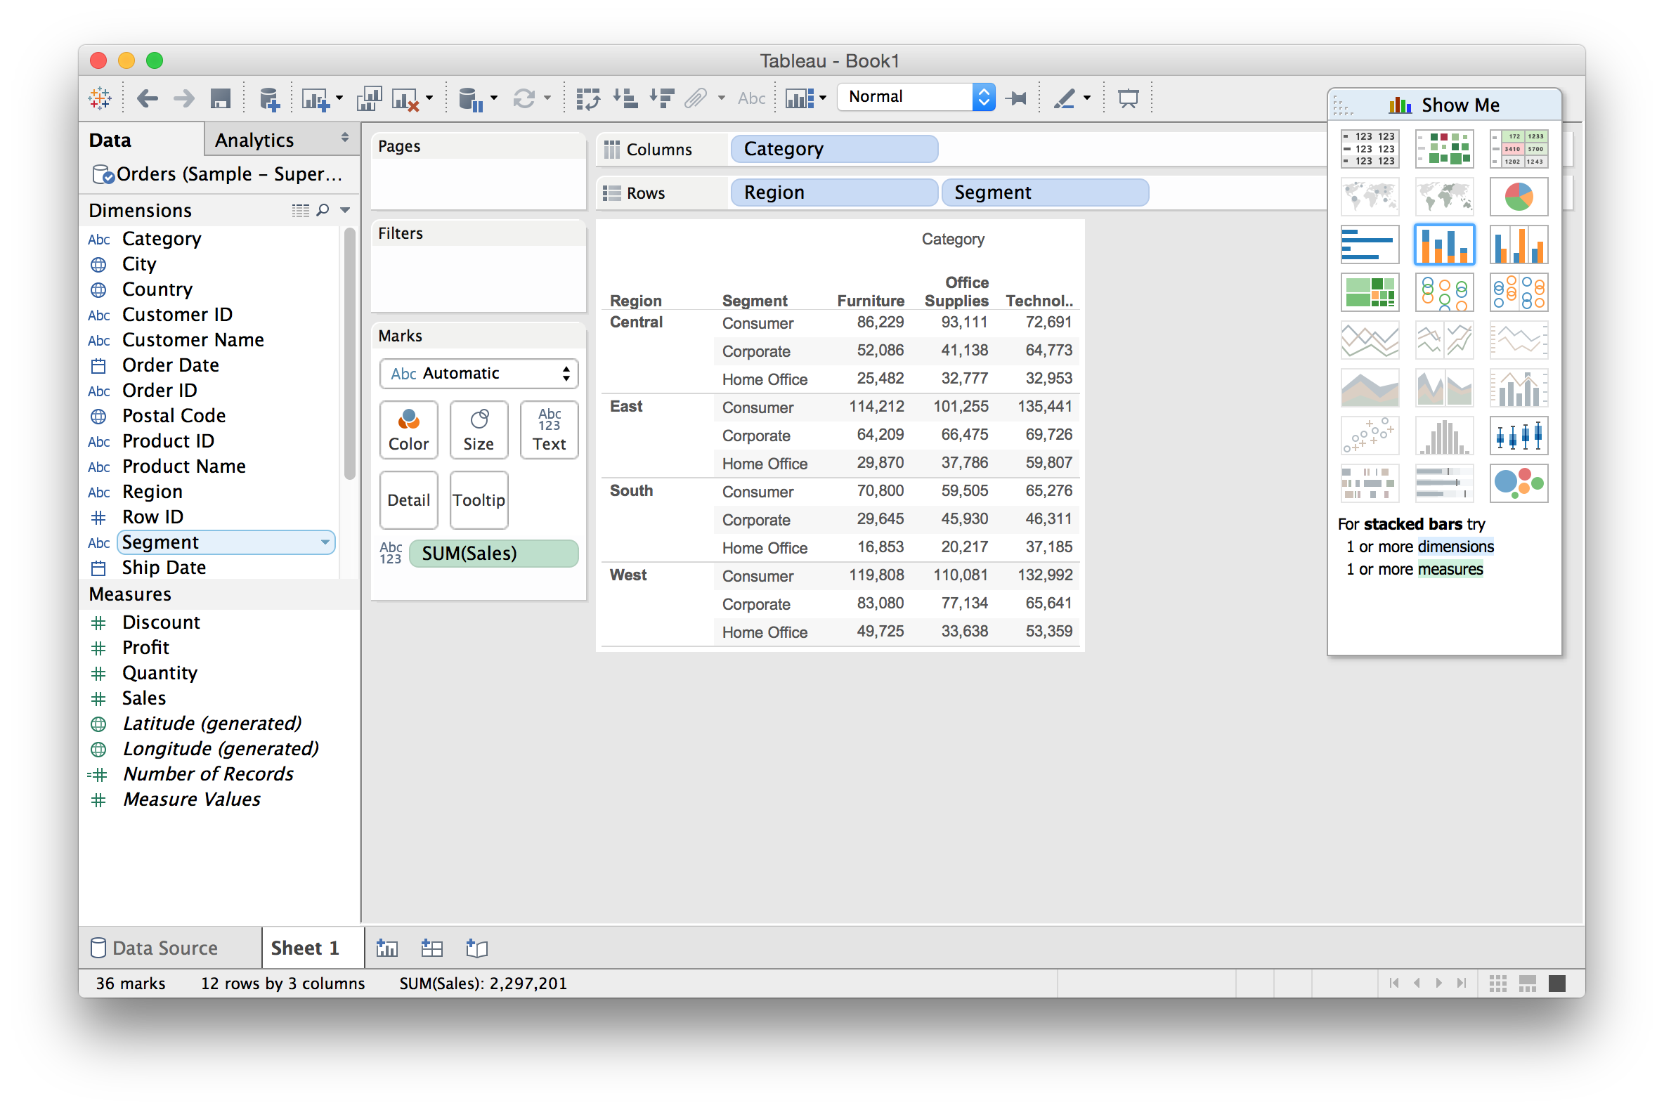
Further refine by subdividing
Tableau basics

Slide 26
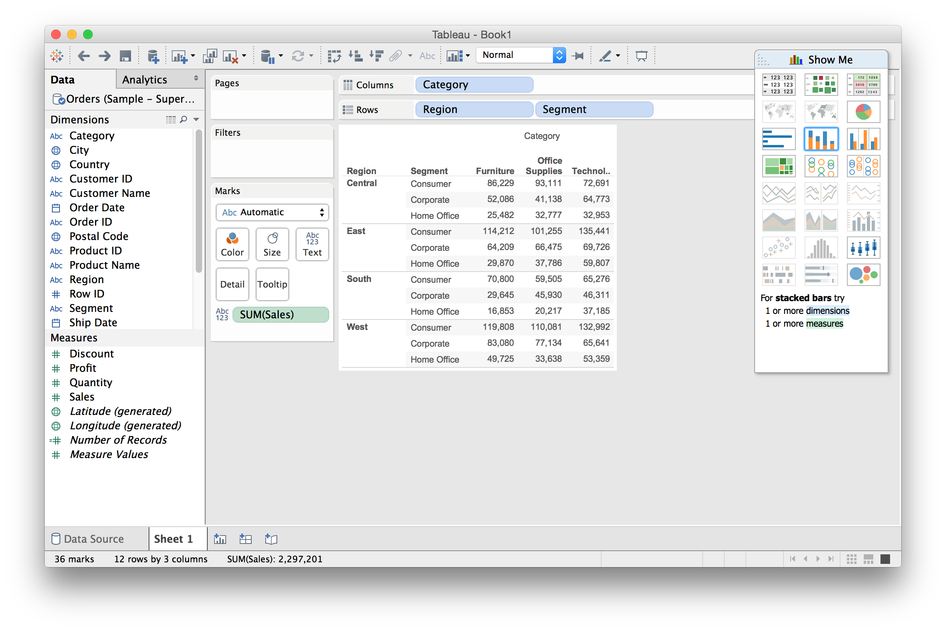
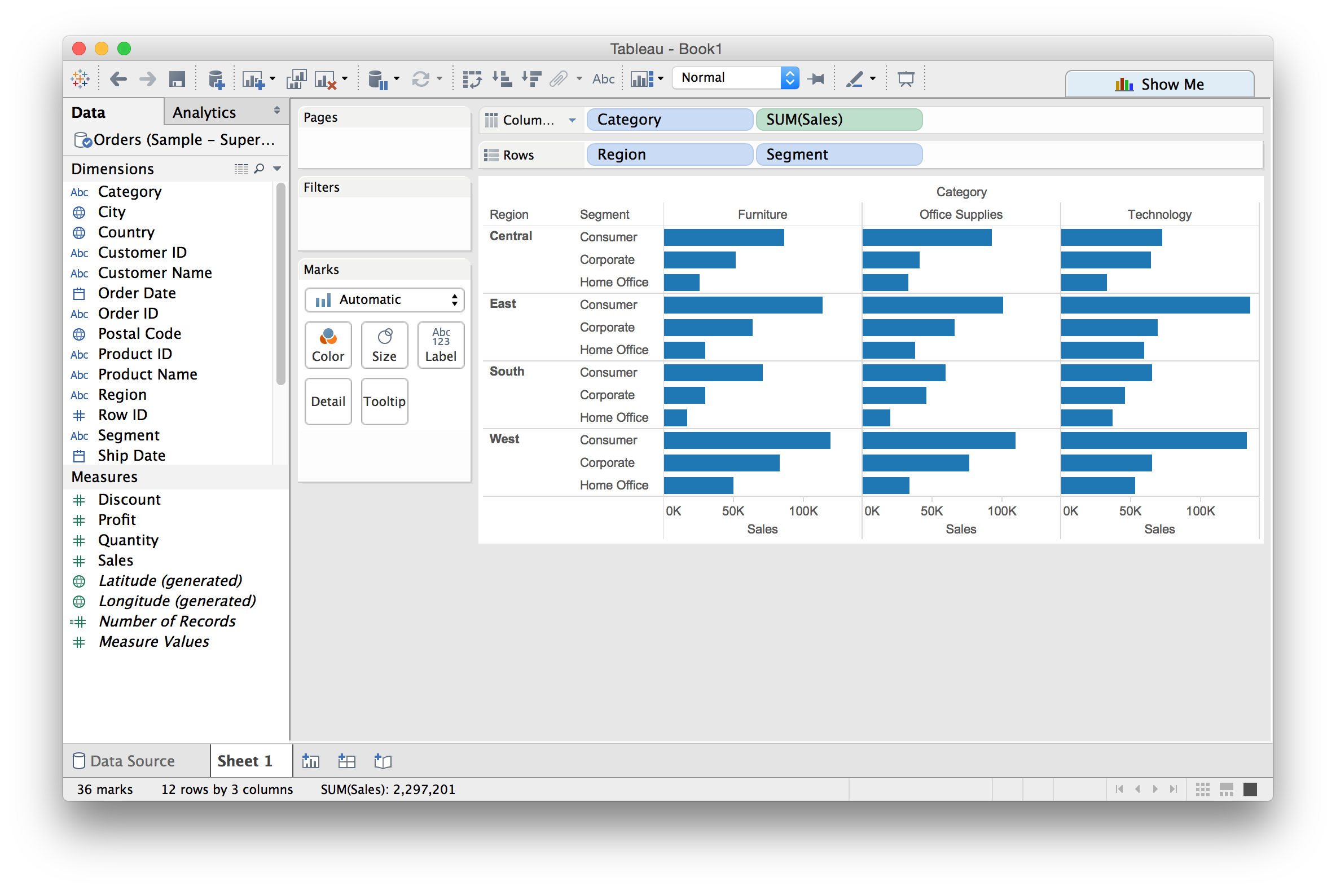
From Text Table to Bar Chart
Tableau basics

Slide 27
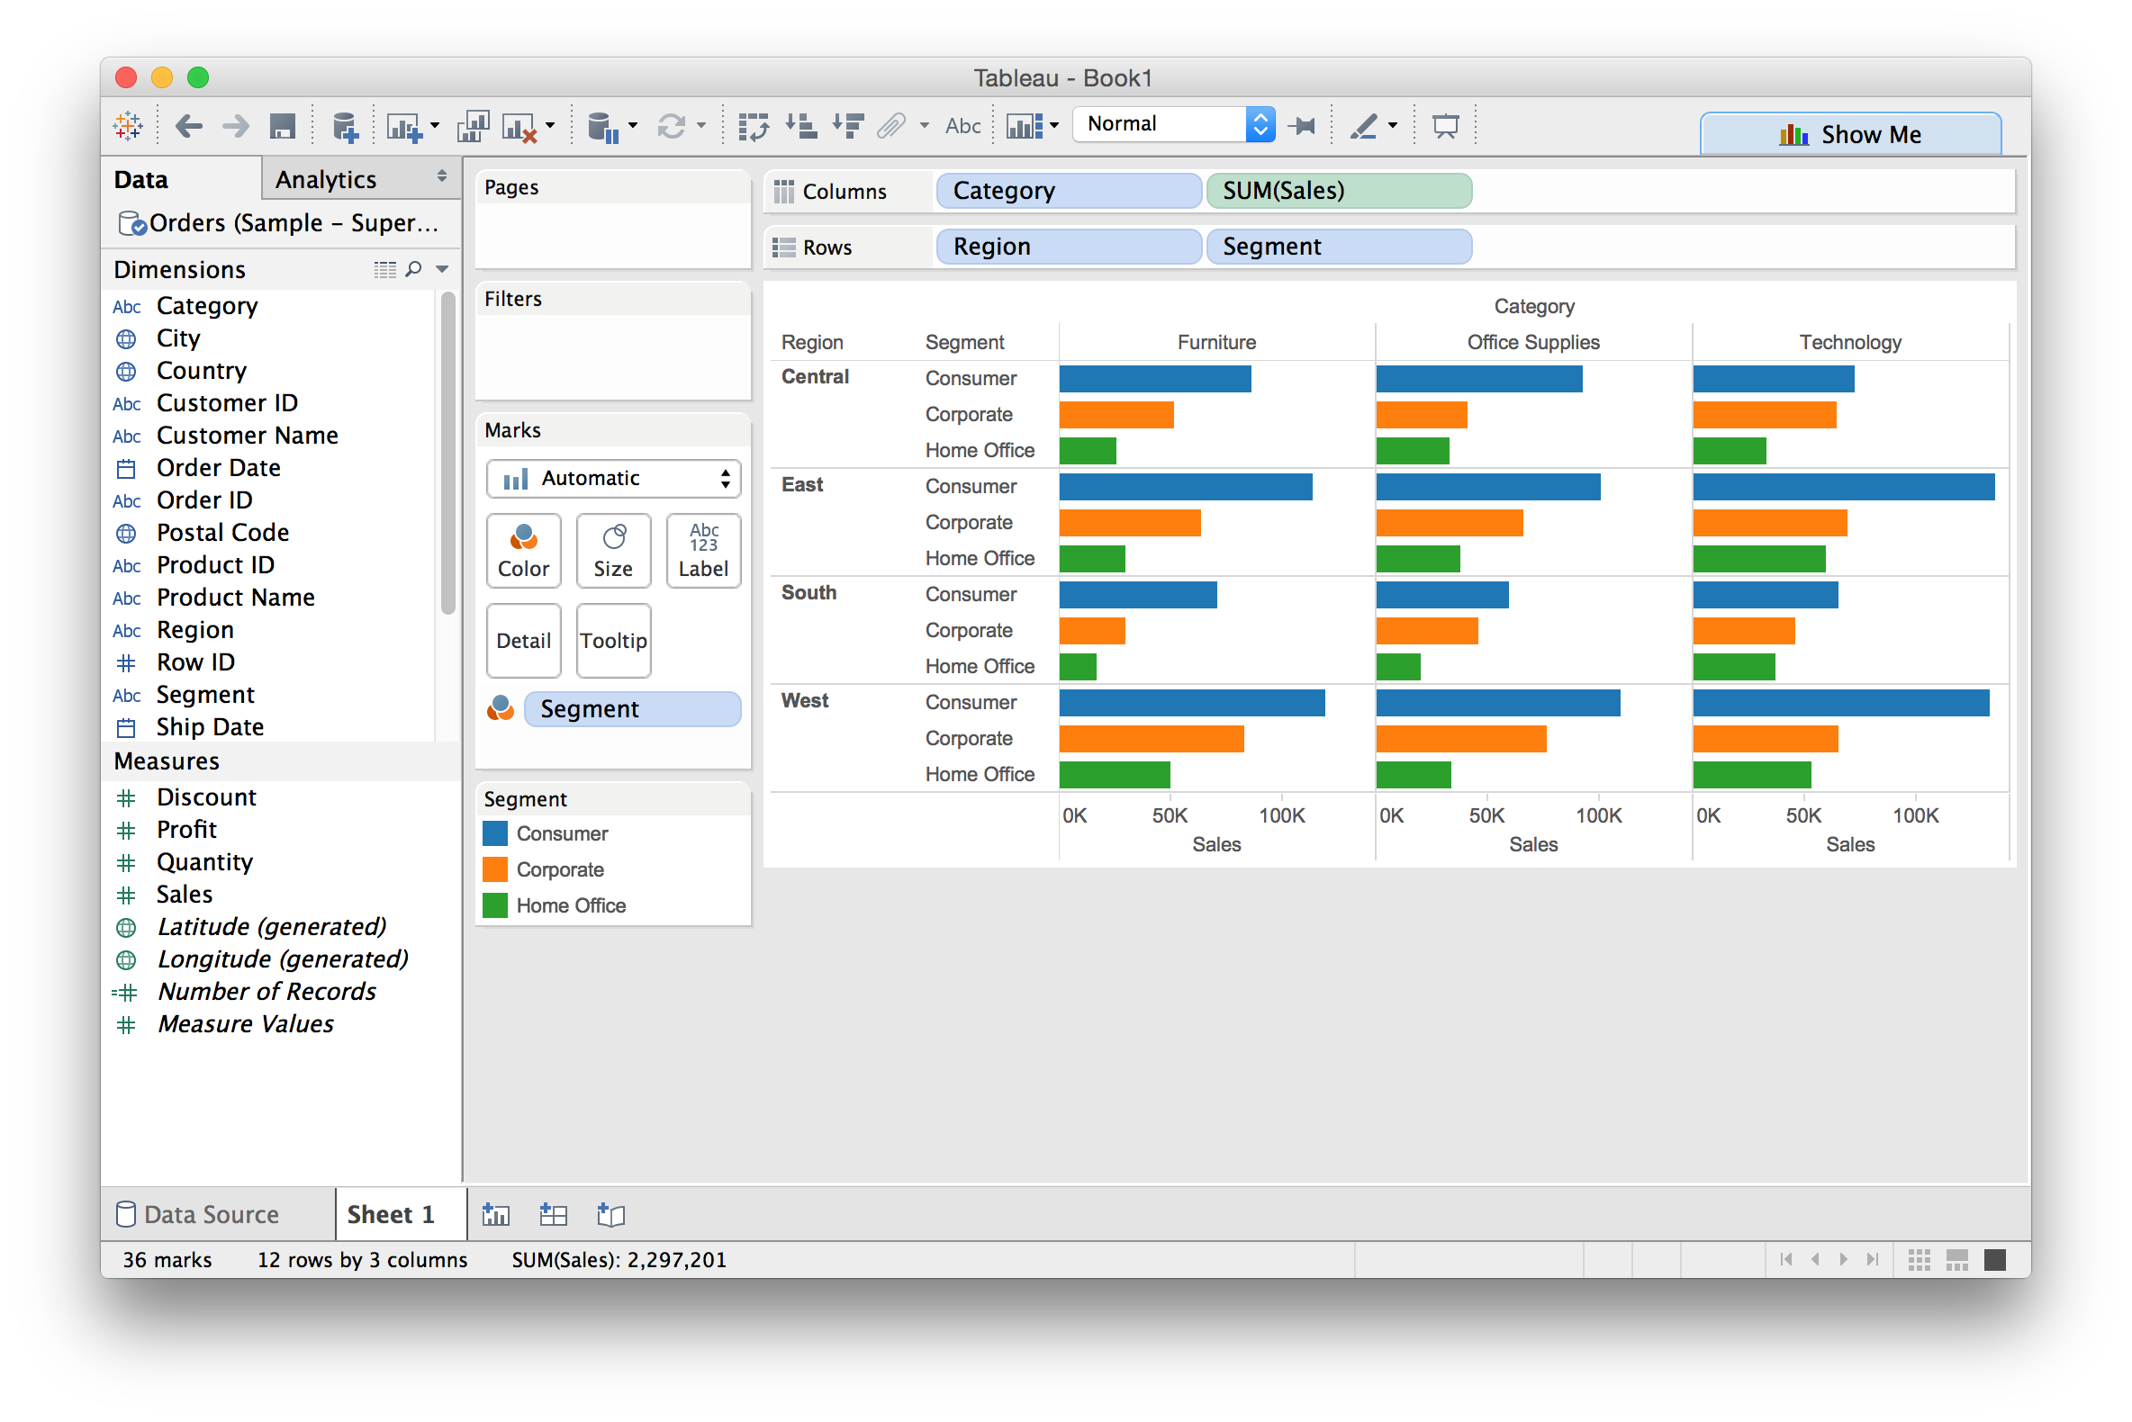
Dual encoding using color
Tableau basics

Slide 28

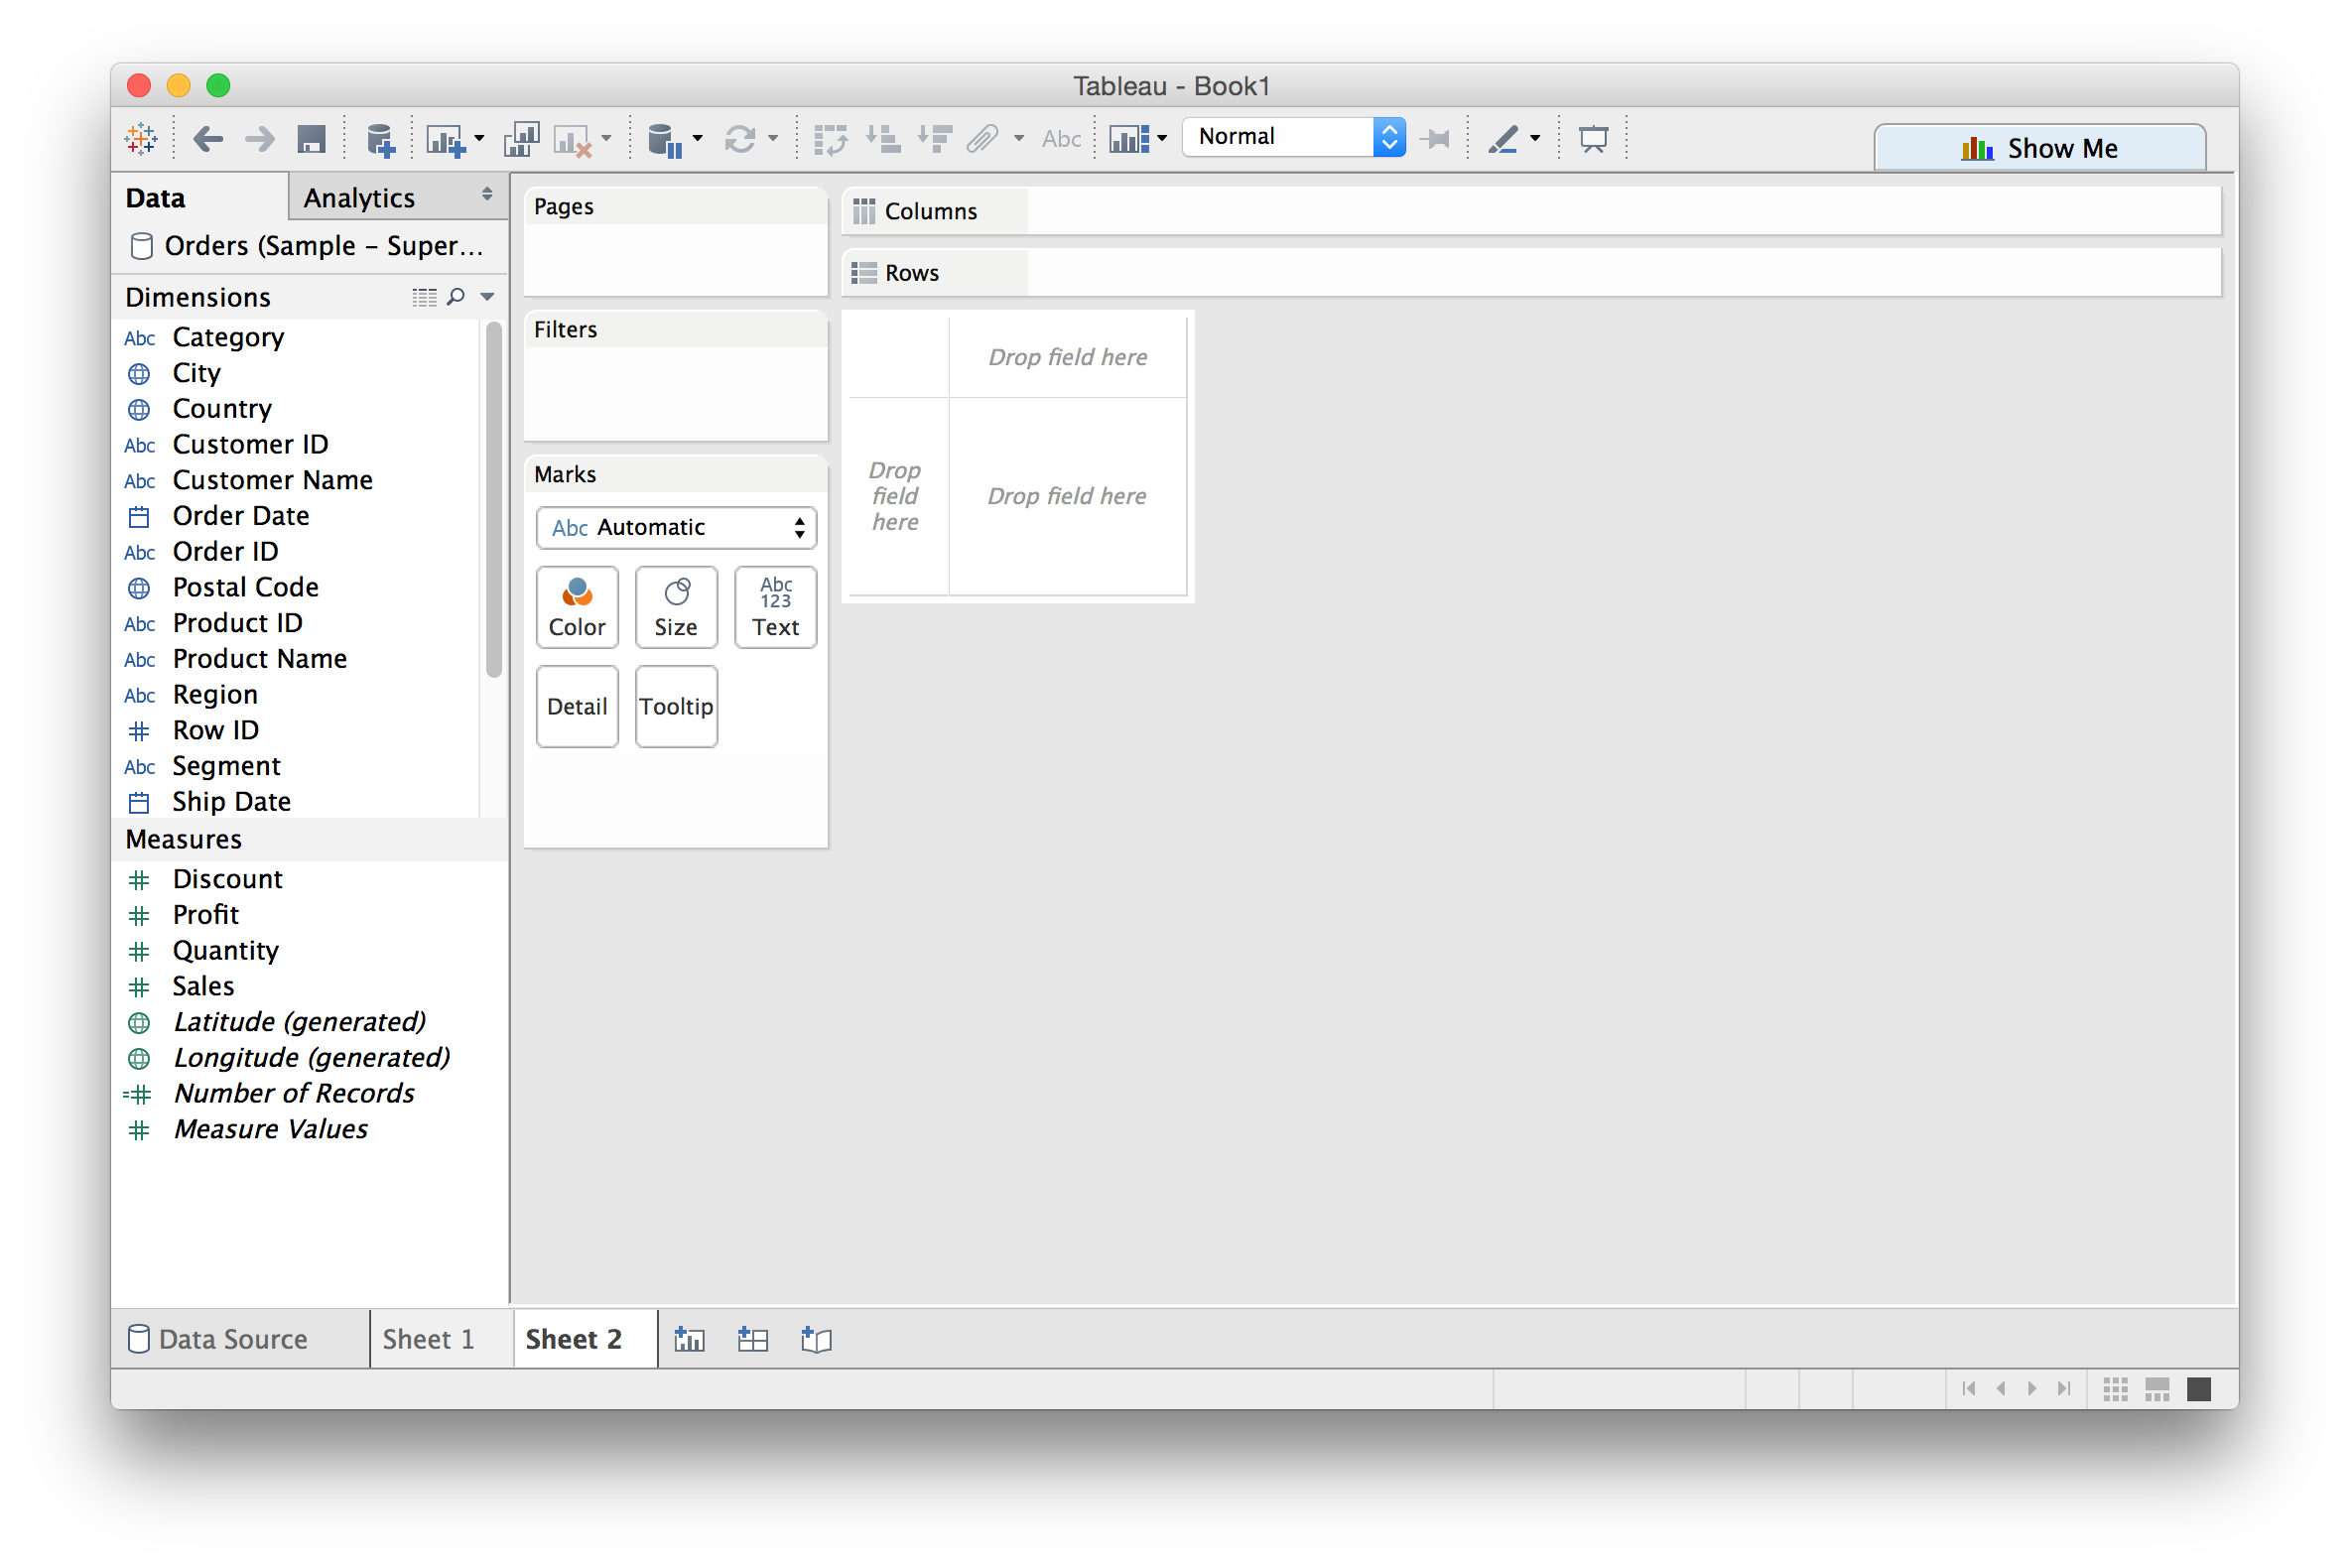
Creating a new sheet
Tableau basics

Slide 29
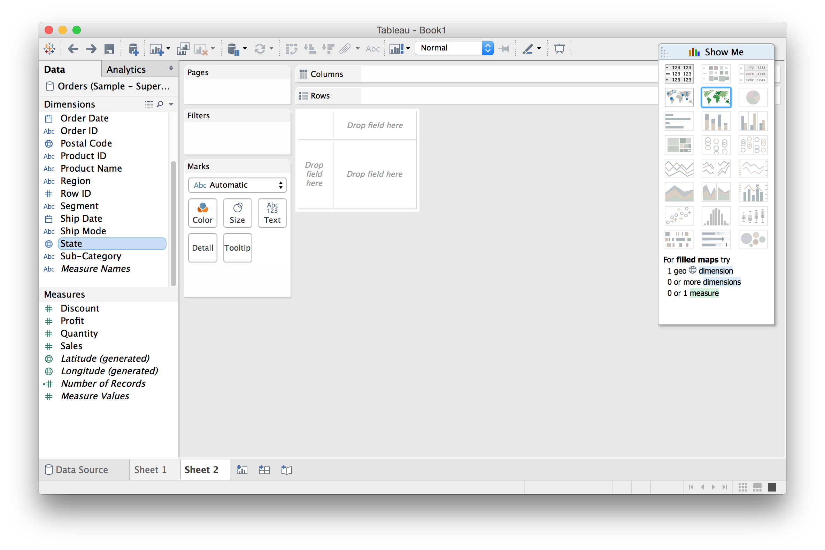
Using “Show Me”: a VIS recommender
Tableau basics

Slide 30
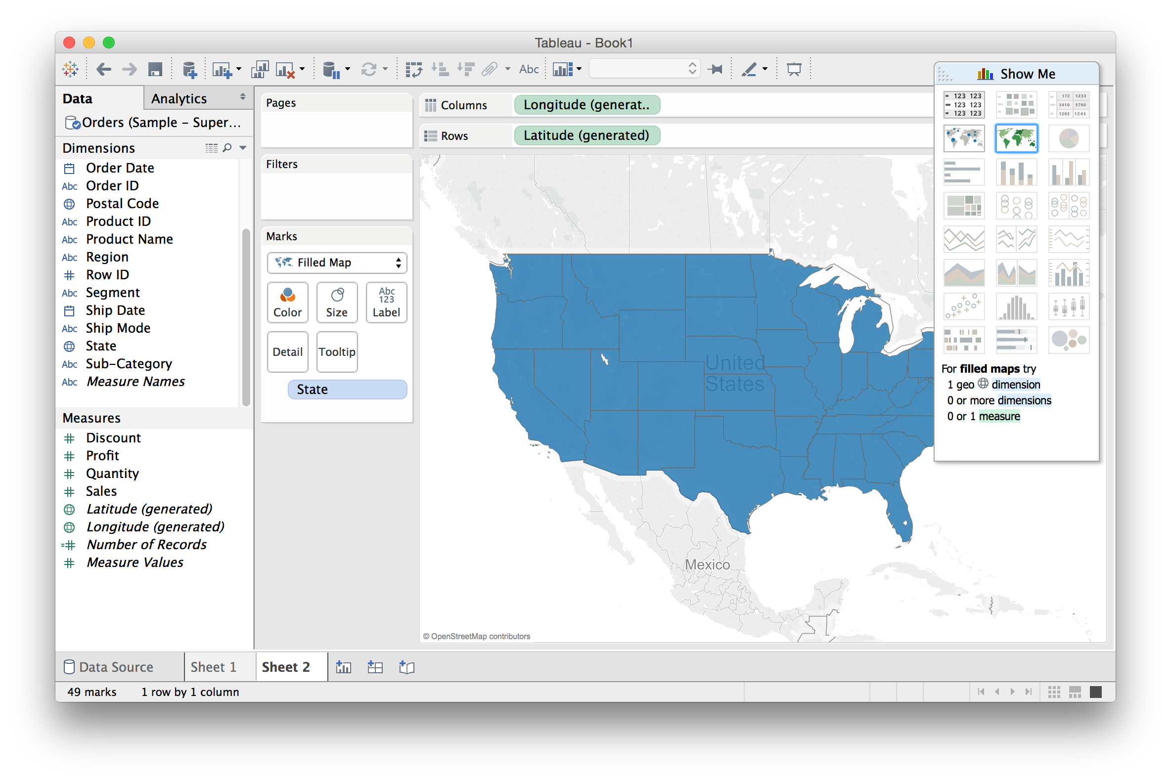
Using “Show Me”: a VIS recommender
Tableau basics

Slide 31
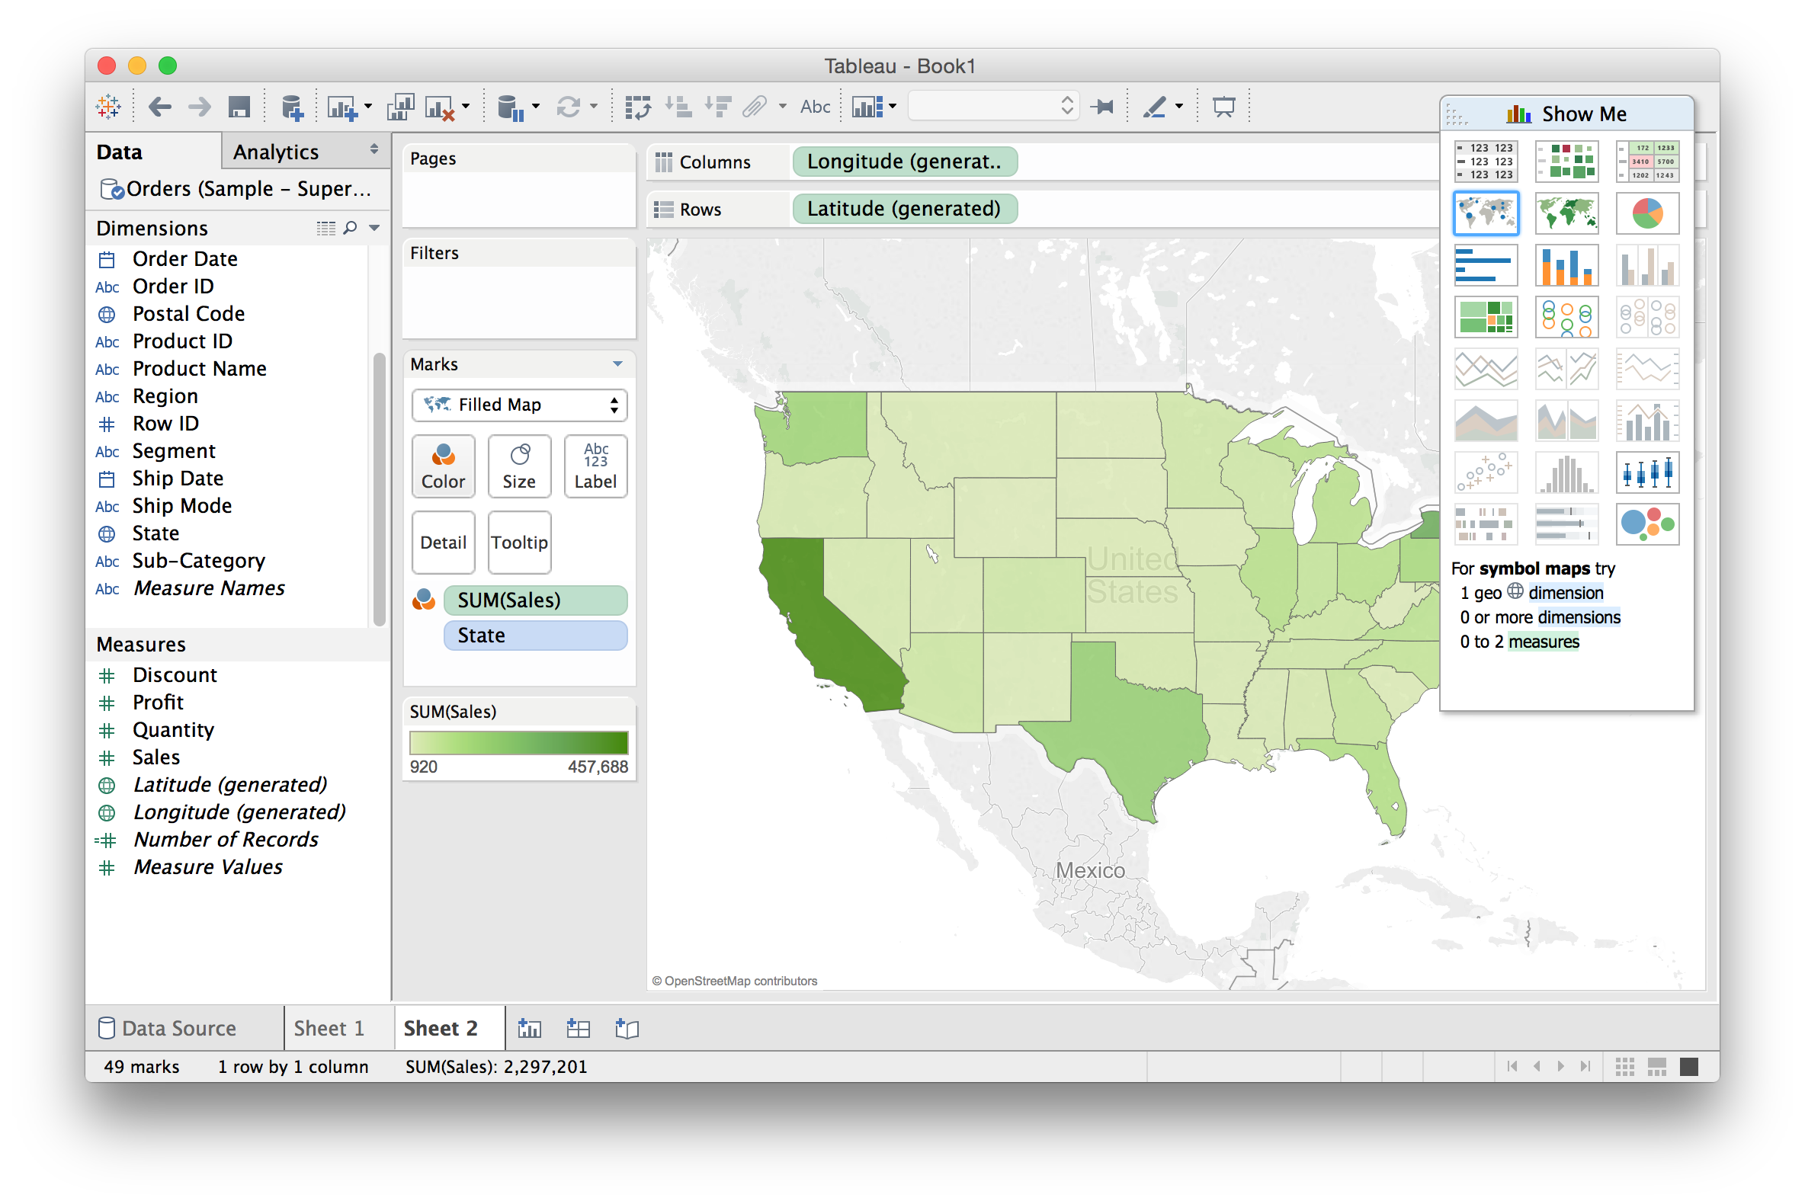
Using “Show Me”: a VIS recommender
Tableau basics

Slide 32
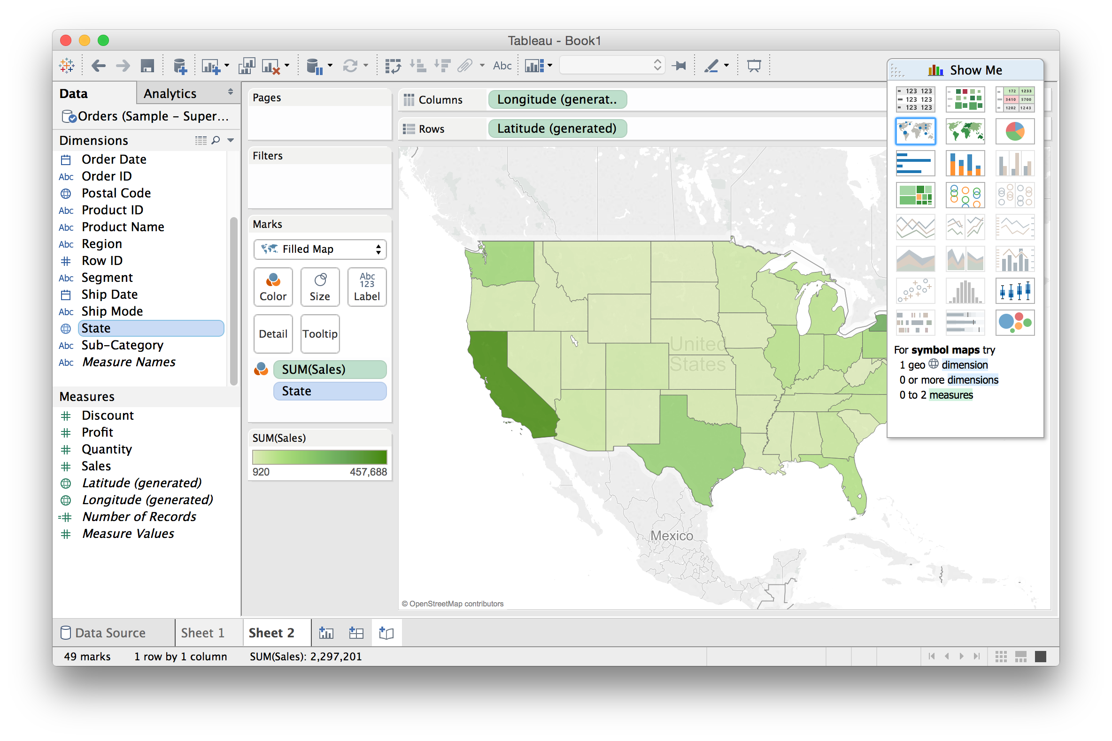
Building Stories from Multiple Views
Tableau basics

Slide 33
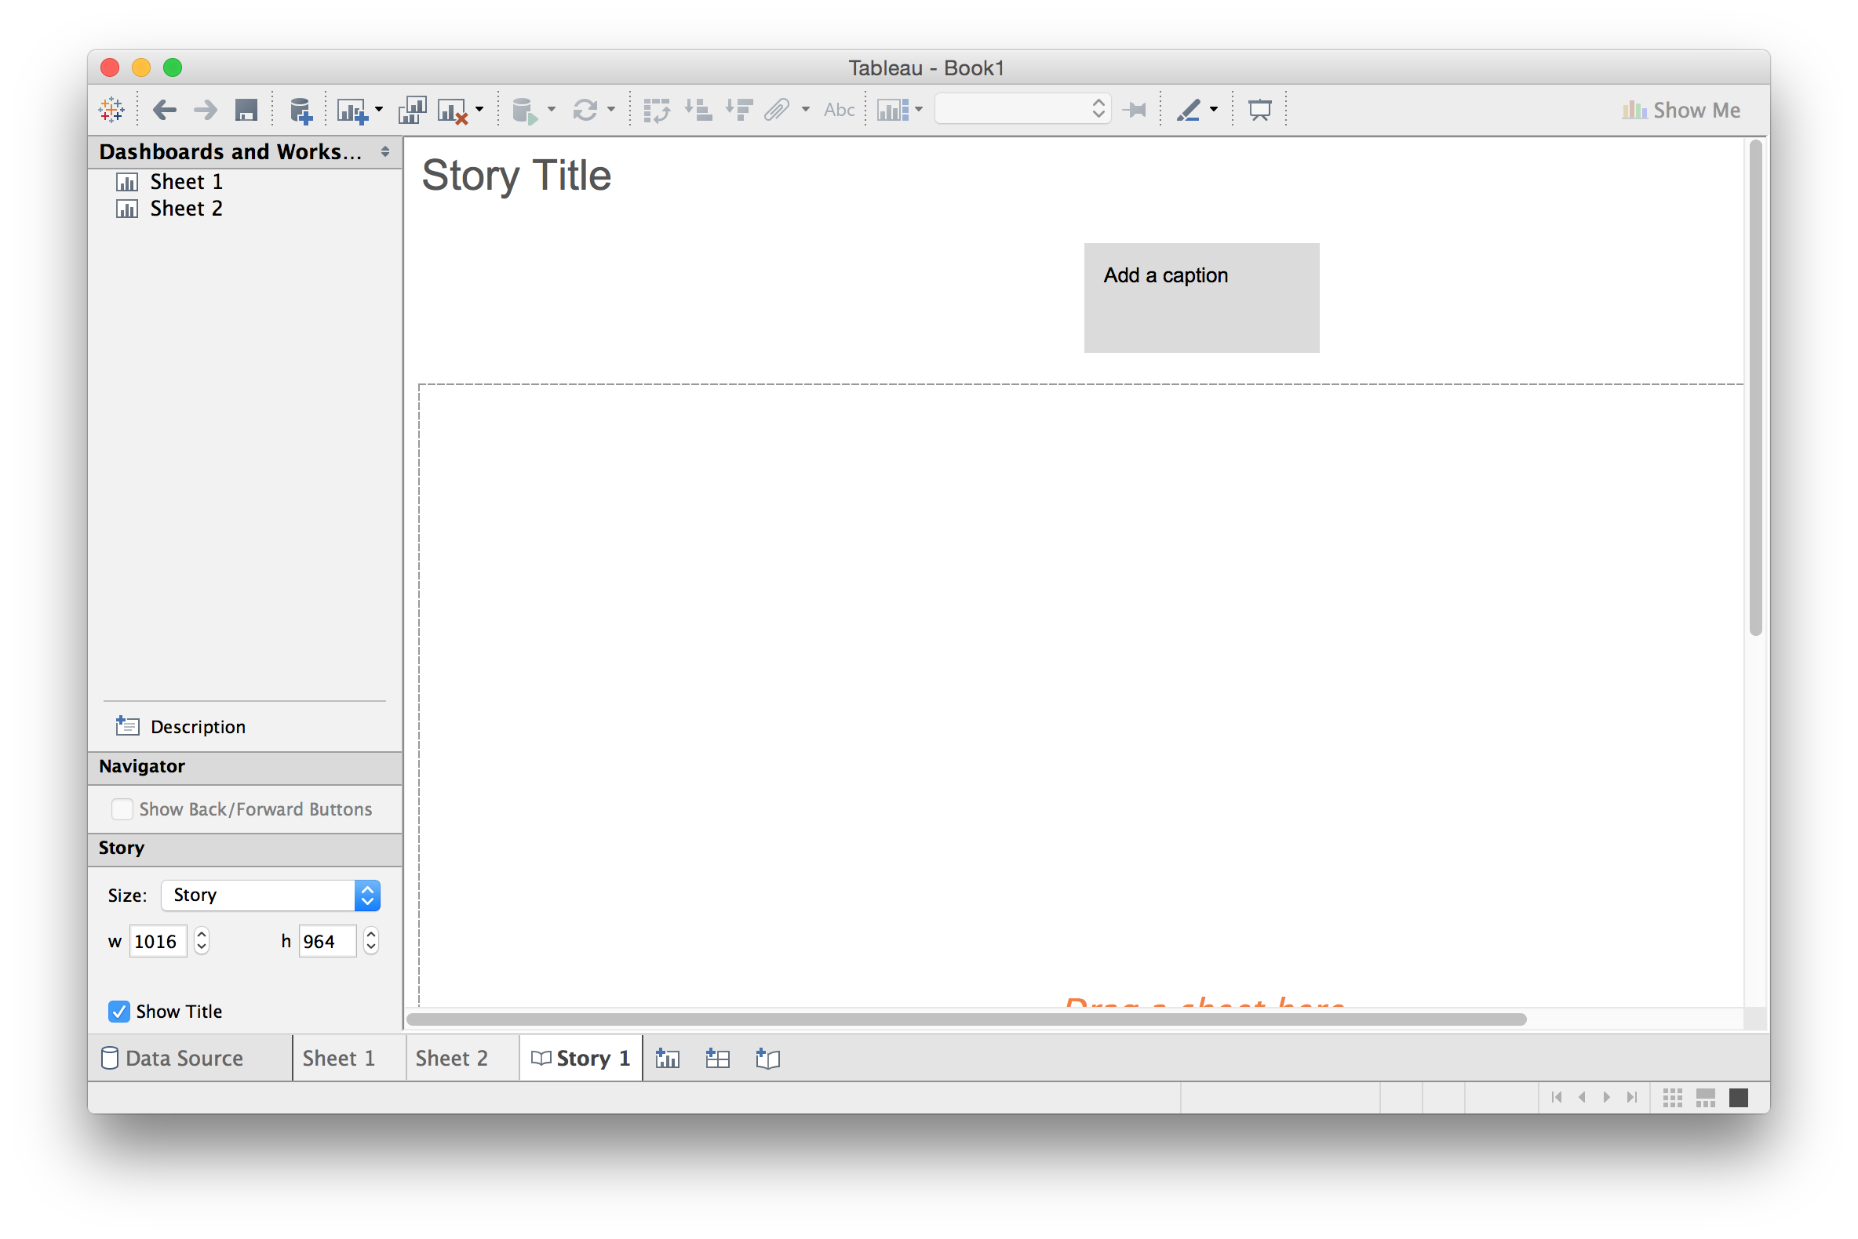
Building Stories from Multiple Views
Tableau basics

Slide 34
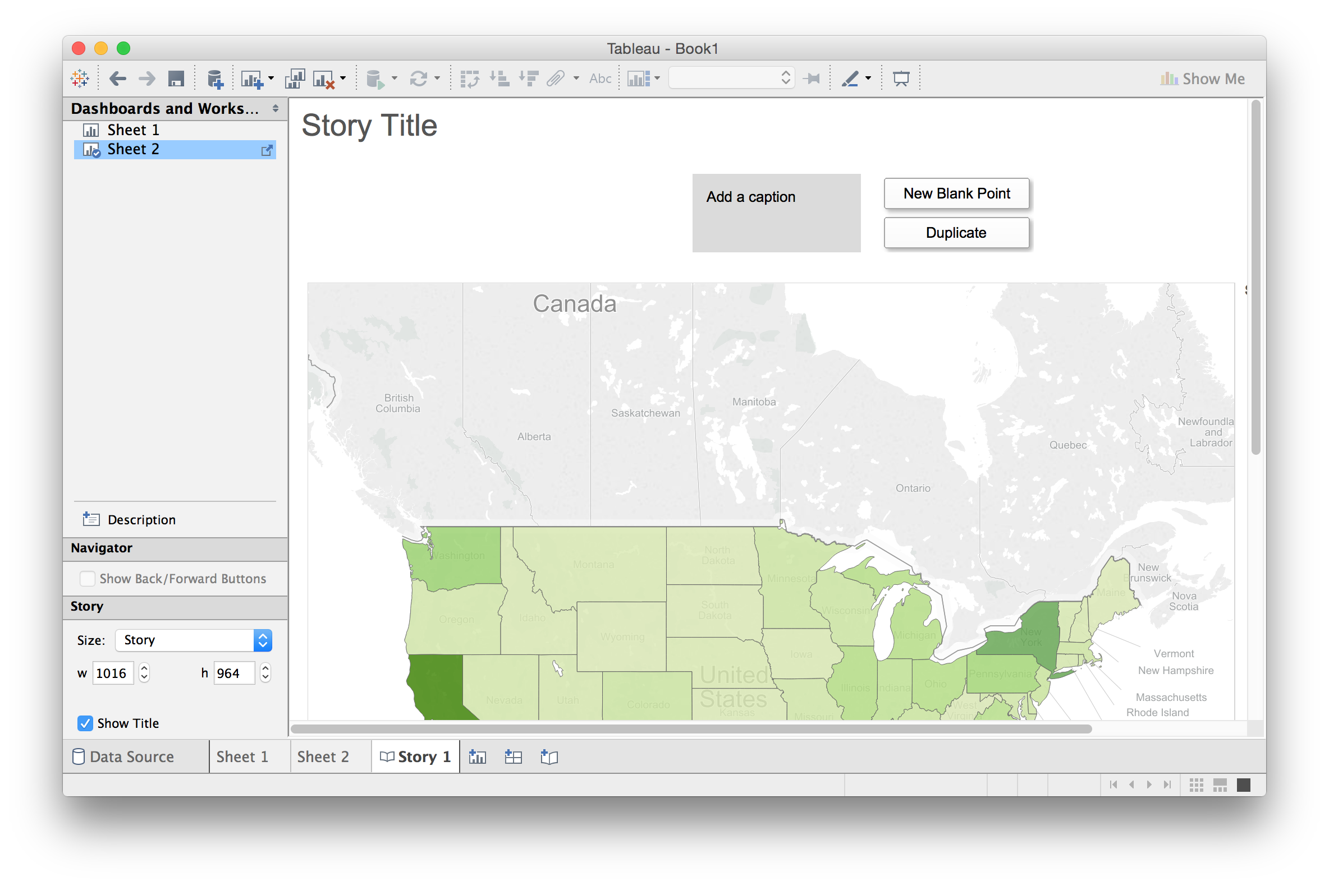
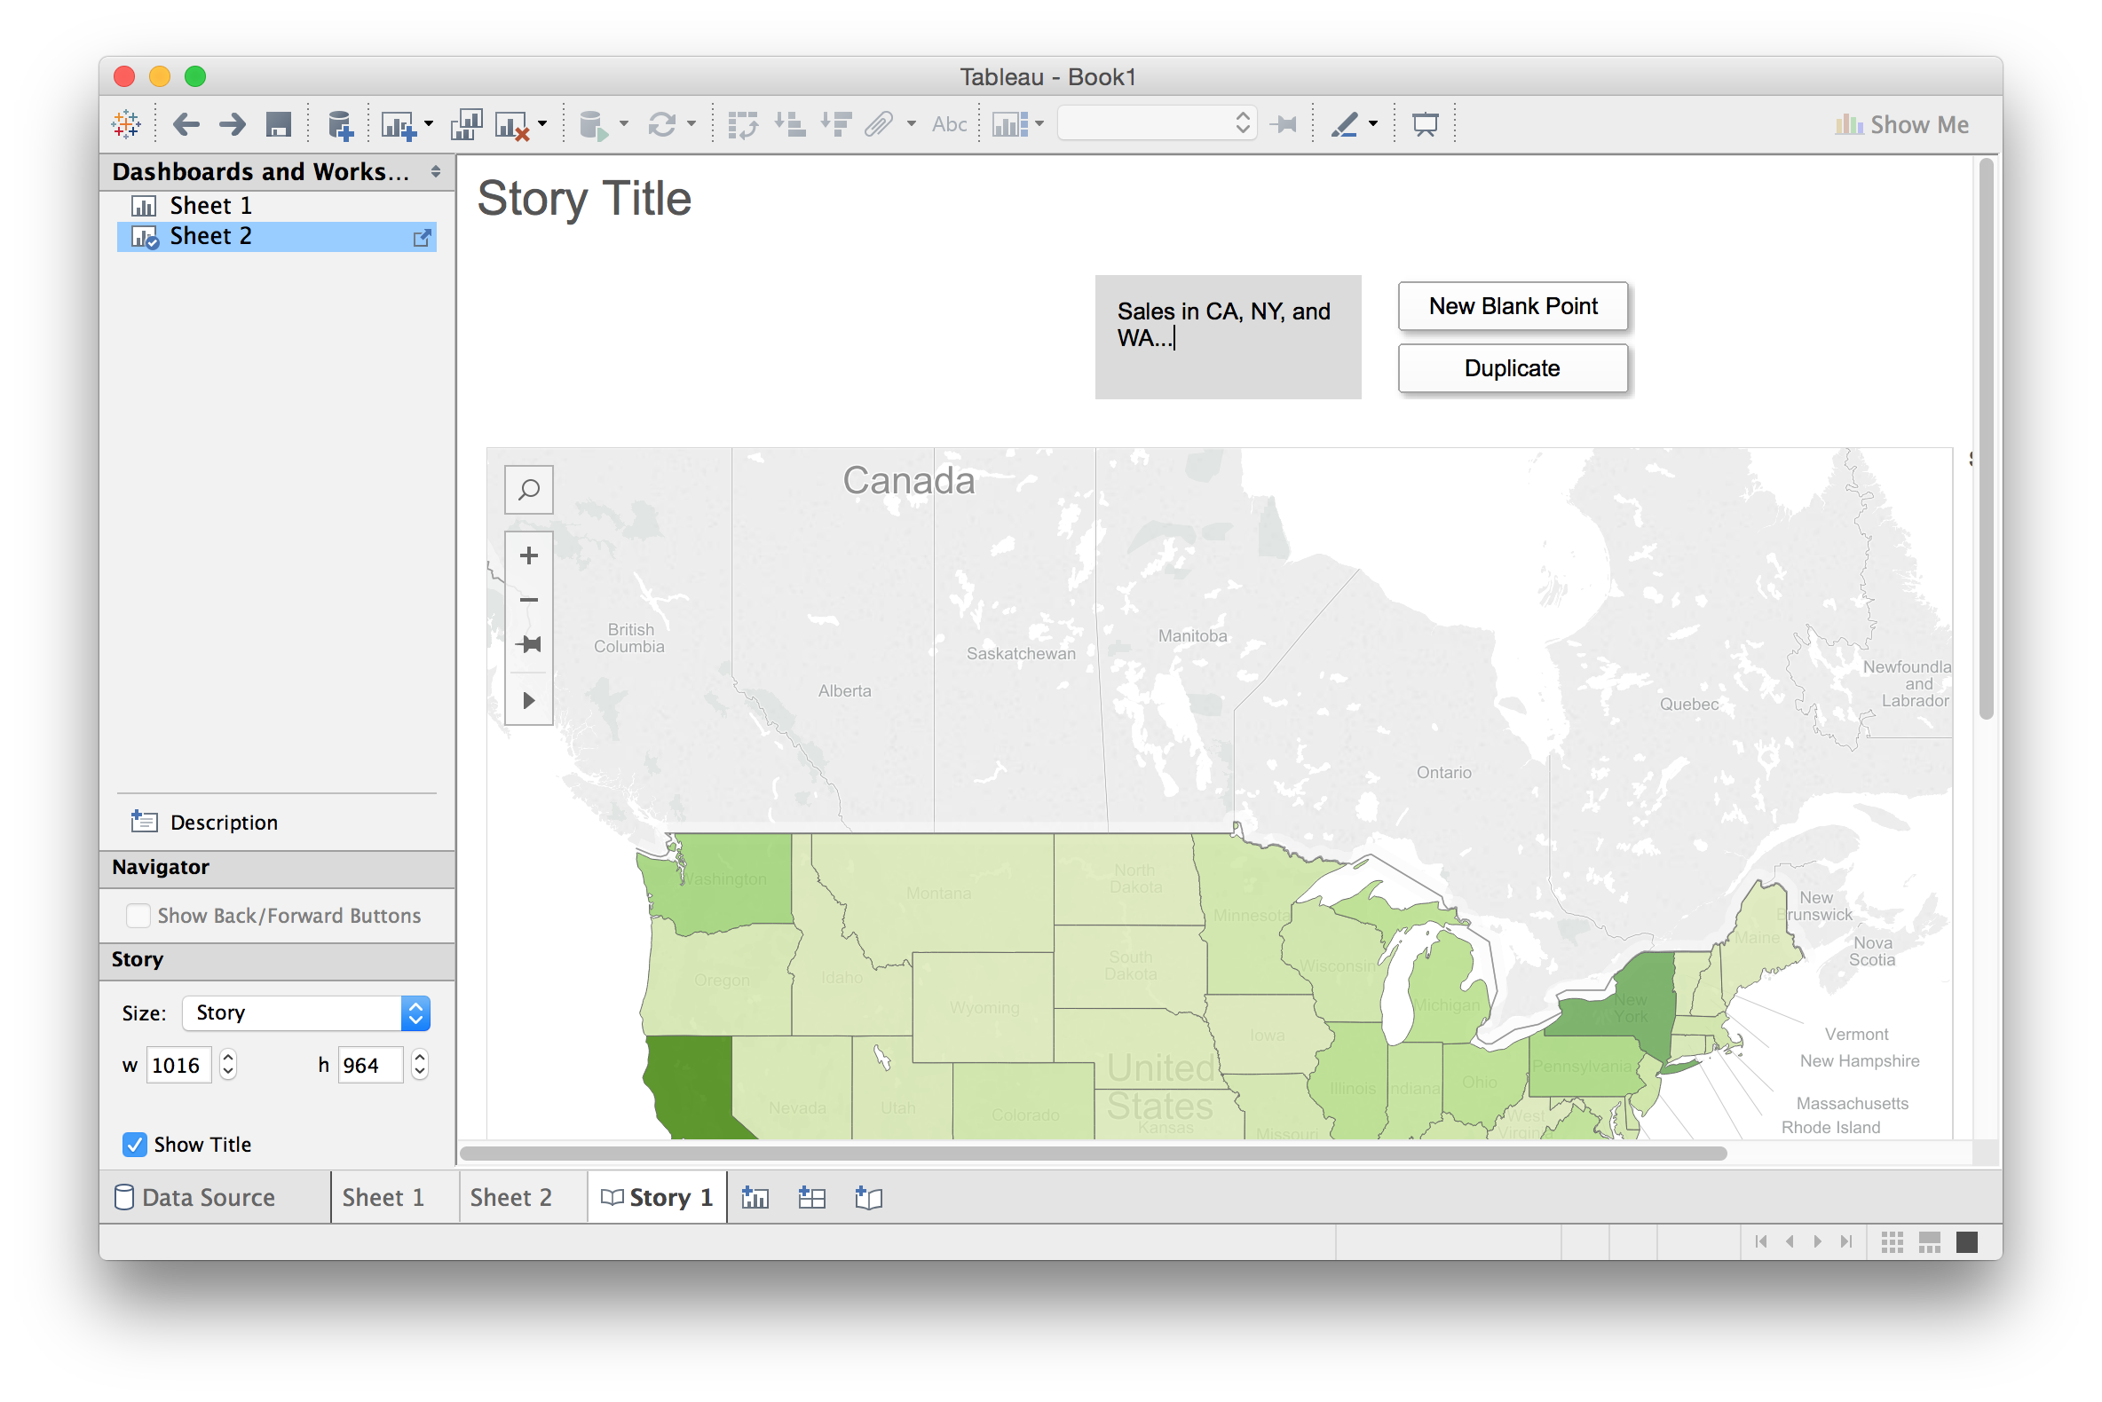
Building Stories from Multiple Views
Tableau basics

Slide 35
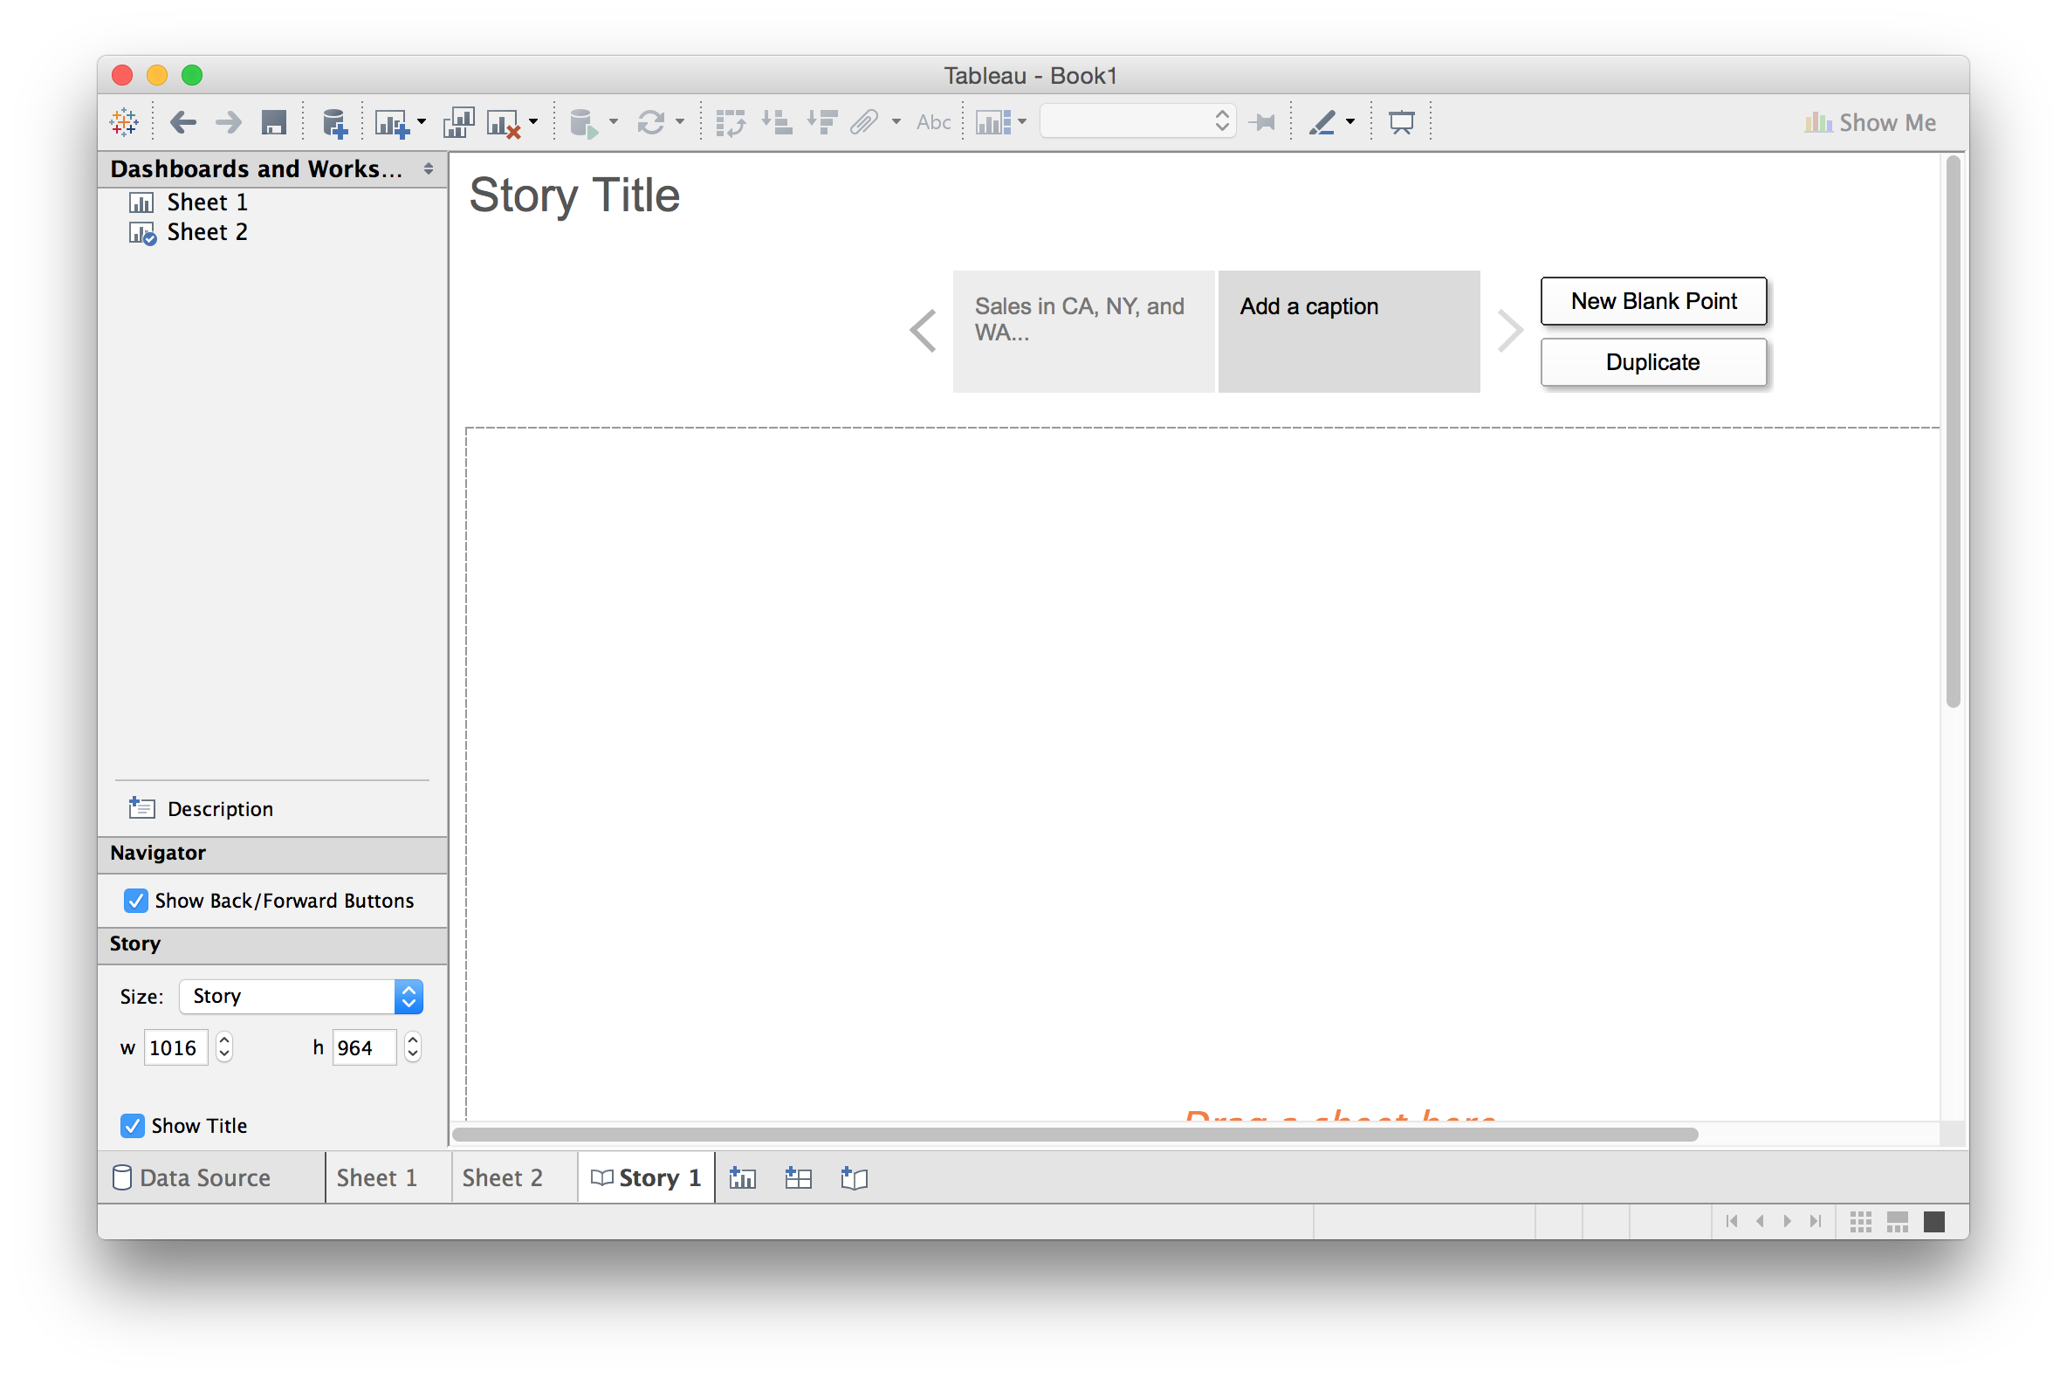
Building Stories from Multiple Views
Tableau basics

Slide 36
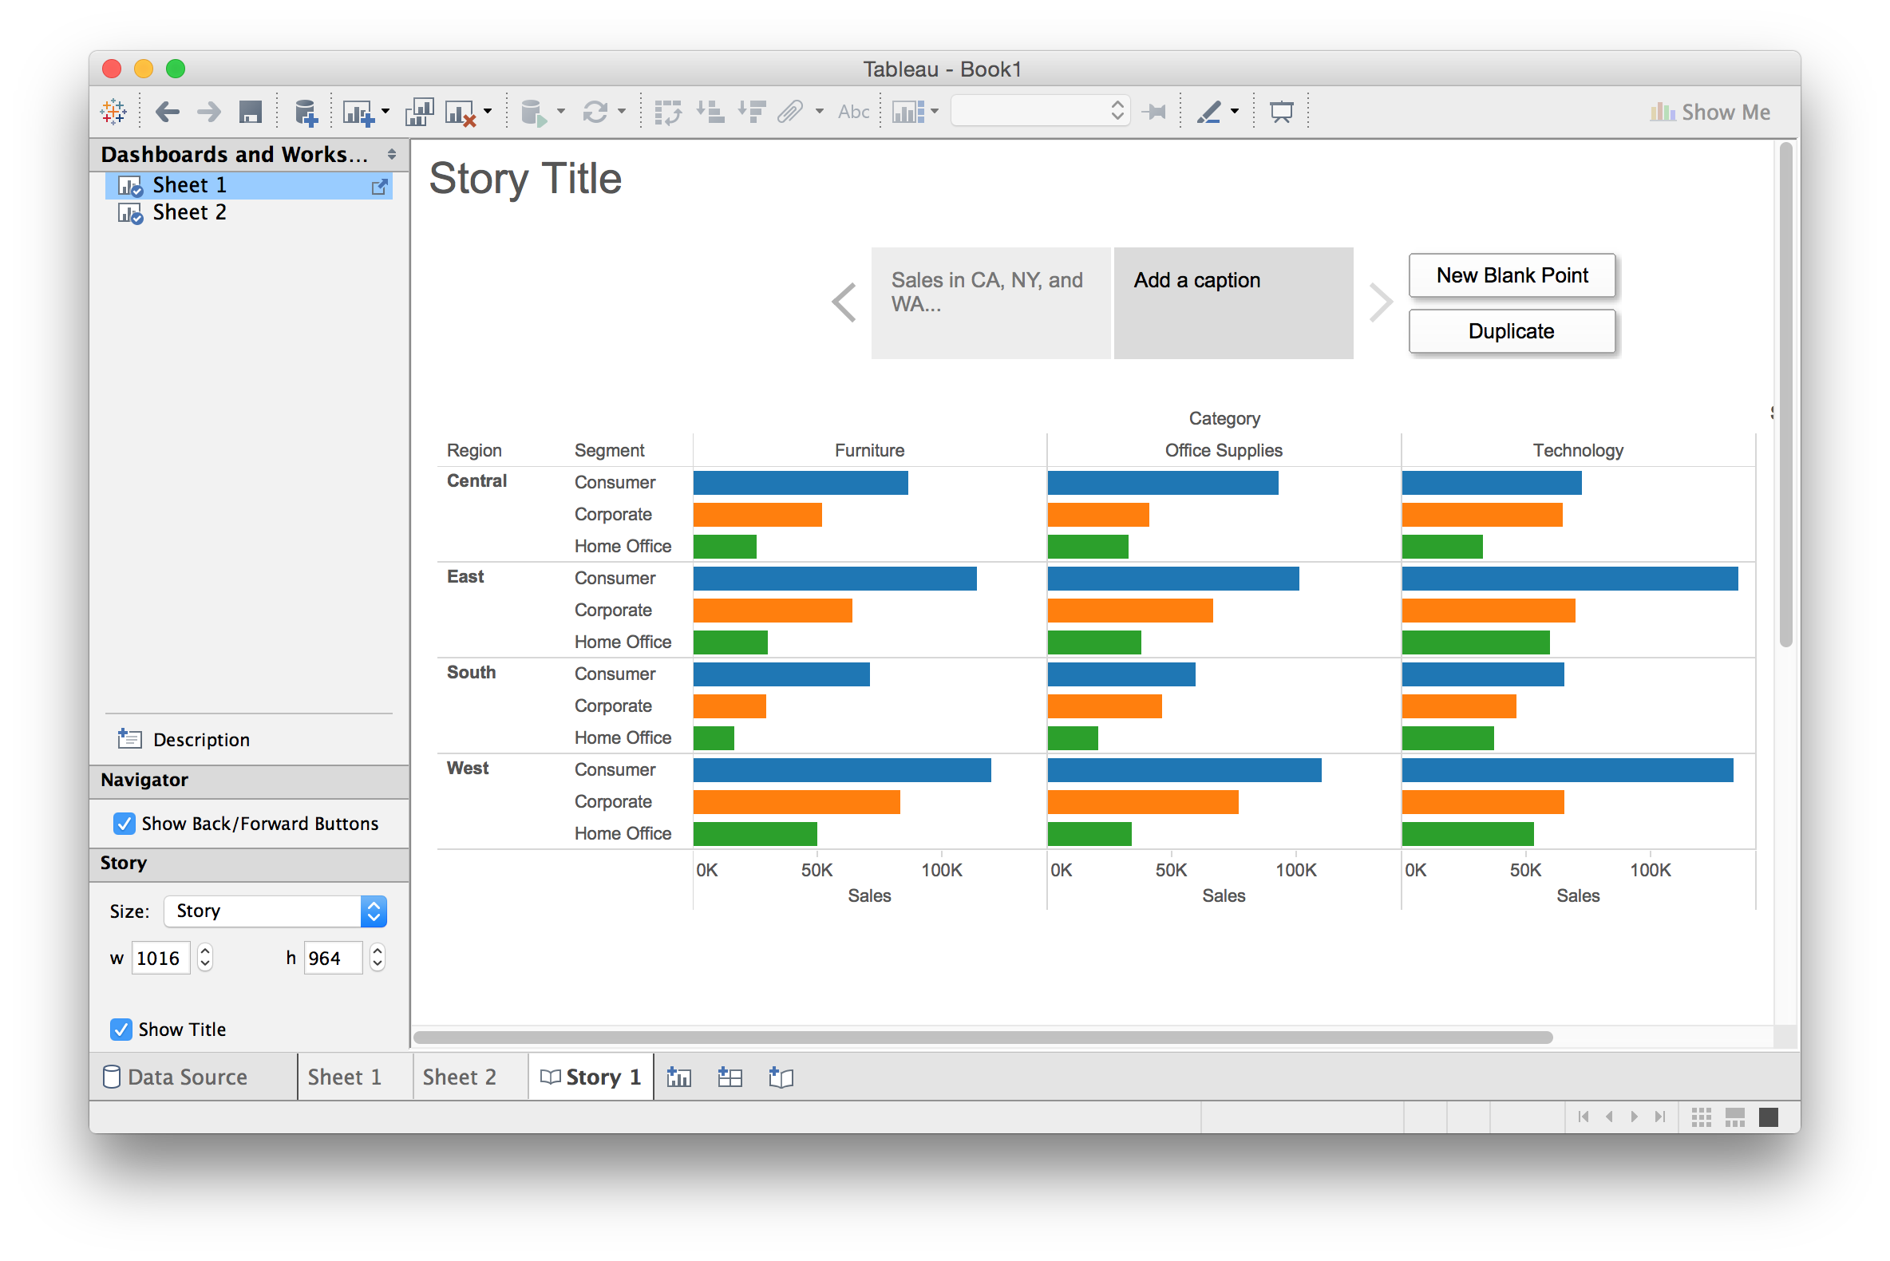
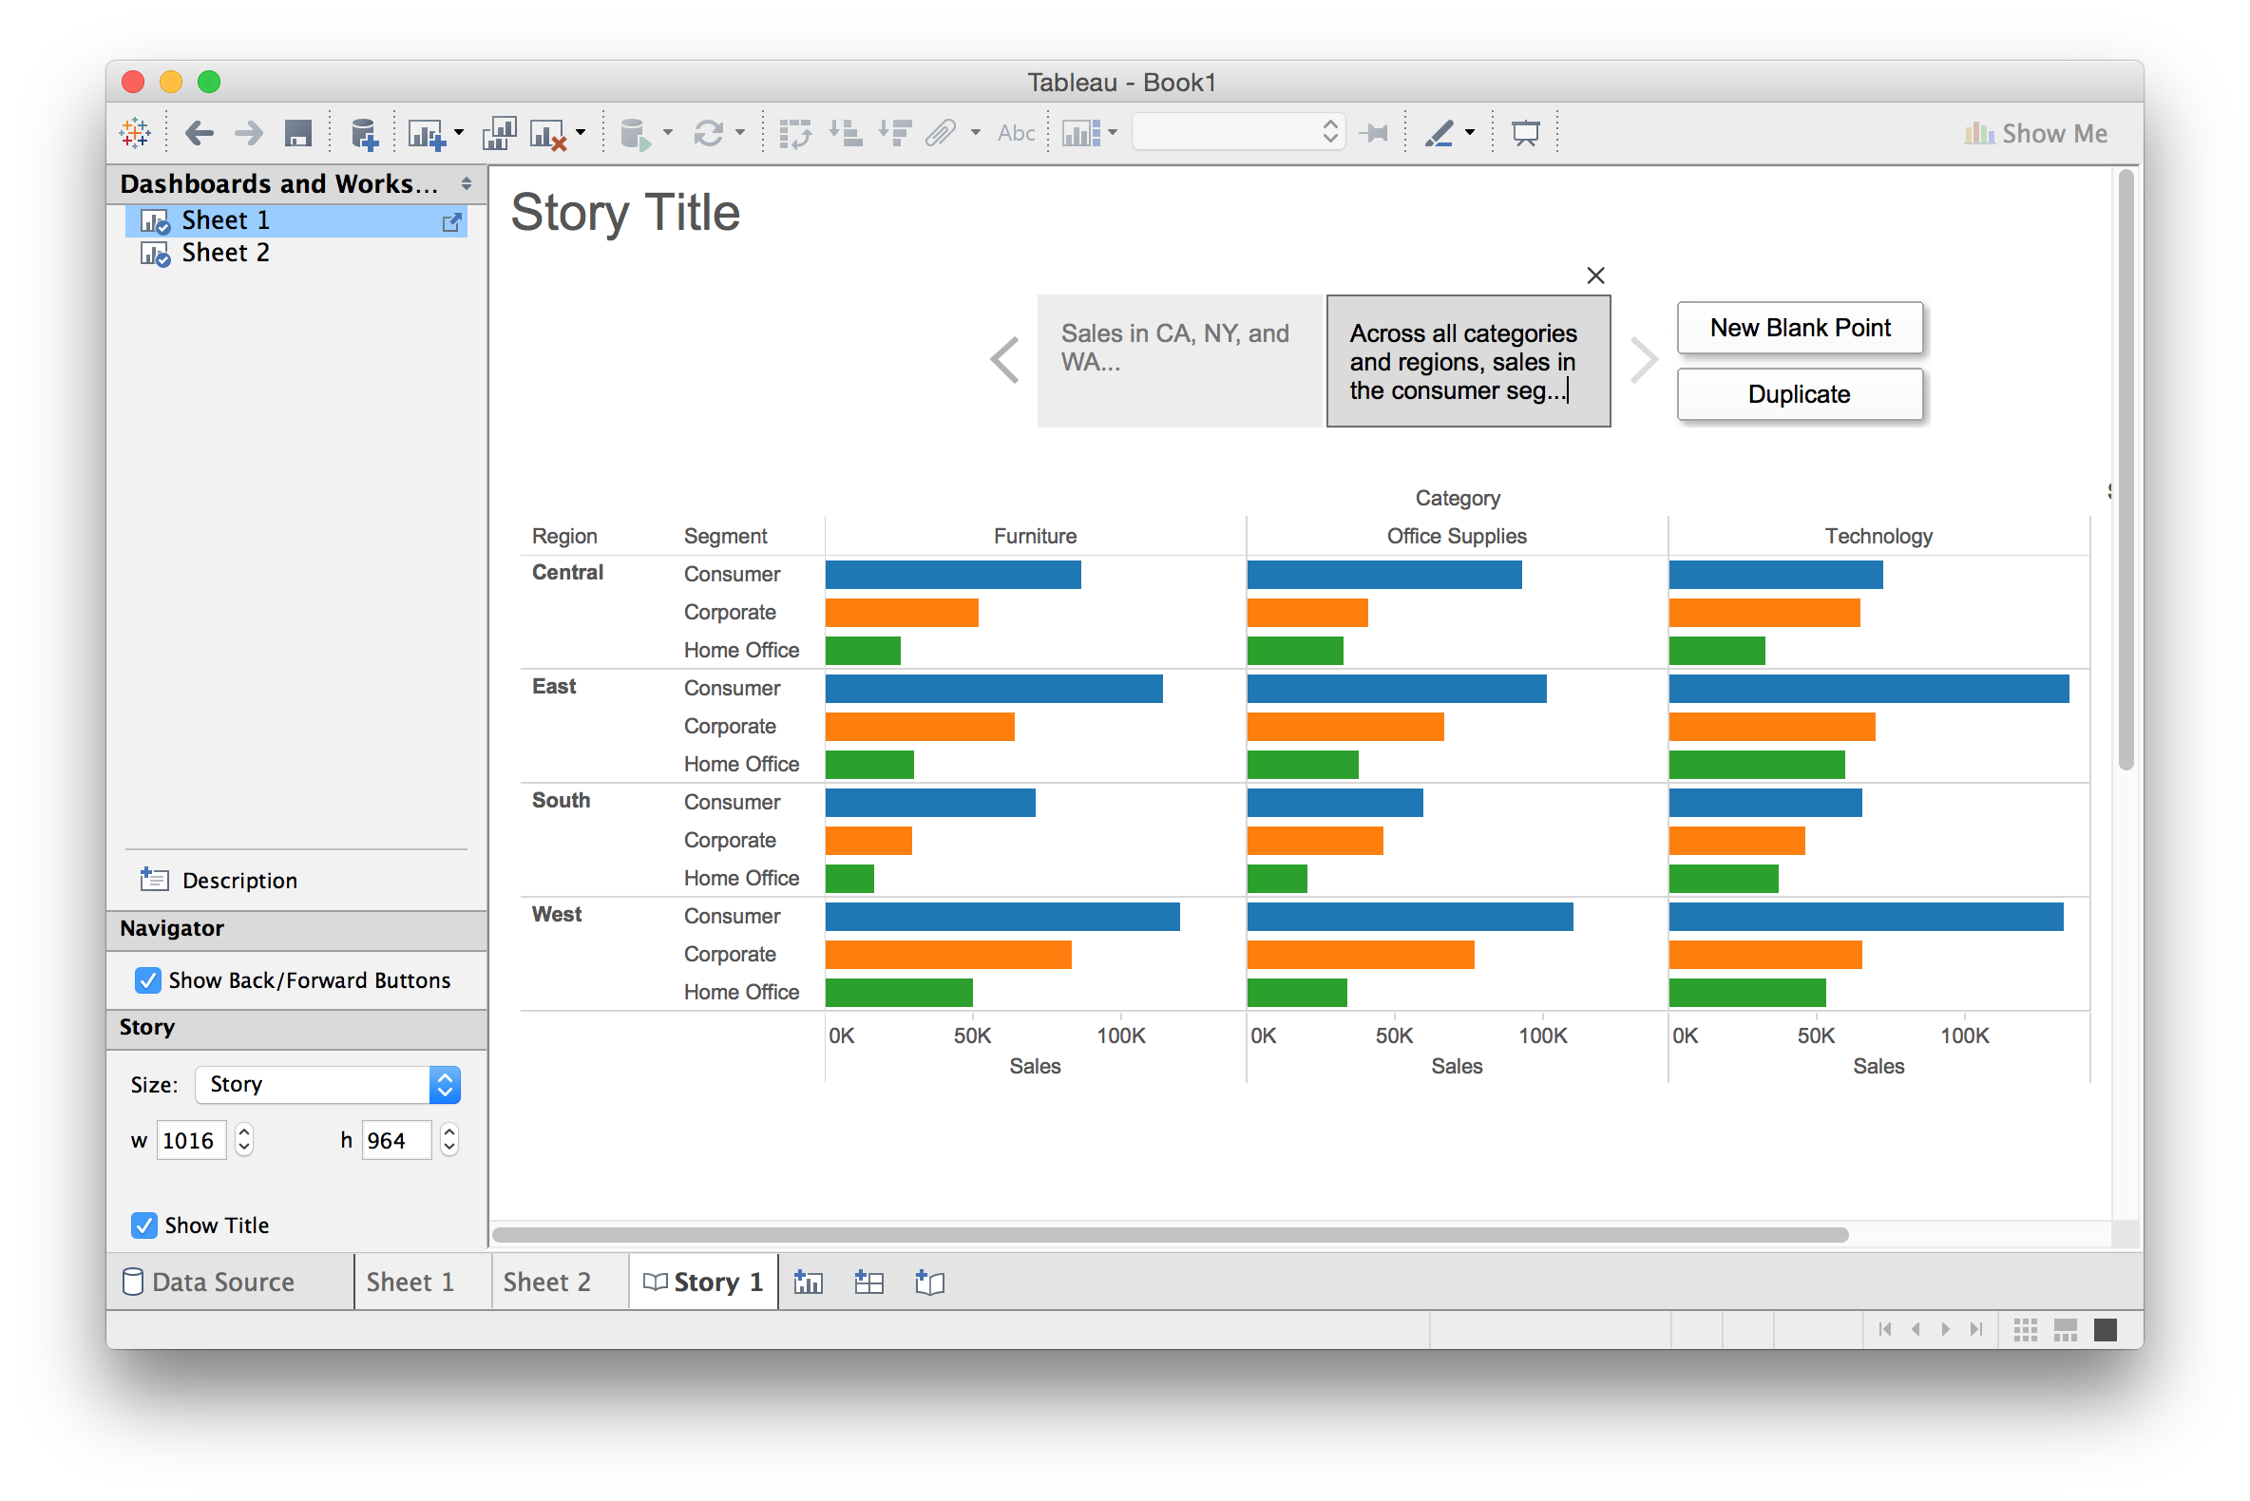
Building Stories from Multiple Views
Tableau basics

Slide 37
Questions?
Tableau basics

Slide 38
Lab pt. 2: Exploring Other Datasets
Tableau basics

Slide 39
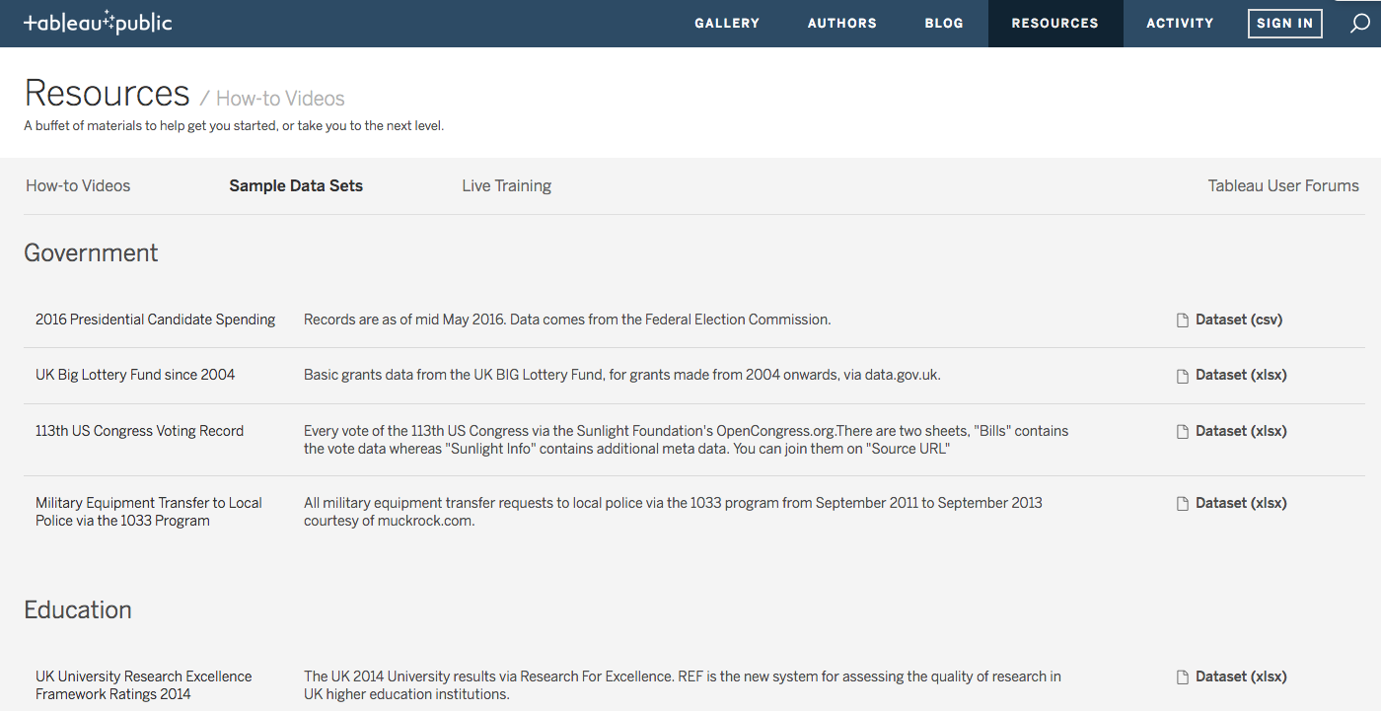
Lab pt. 2: Exploring Other Datasets
Tableau basics
goo.gl/kcbqfc

Slide 40
Discussion
Tableau basics
What are some of Tableau’s strengths? Weaknesses?
Was there anything you couldn’t figure out?

